Slide 1
Welcome
NFPA® 99
Healthcare Facilities Code
2012 Edition
Maintenance of Med Gas / Vacuum Systems
Thursday, October 19, 2017

Slide 2
Presenter
Jay D’Agostino
Business Development Manager
Scales Medical Technologies

Slide 3
Chapter 5
Maintenance of Medical Gas, Vacuum, WAGD, and Medical Support Gas Systems

Slide 4
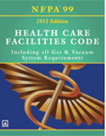
CMS
Center for Medicare & Medicaid Services
Currently following the 2012 Edition of NFPA 101 Life Safety Code
References the 2012 Edition of NFPA 99 Healthcare Facilities Code

Slide 5
5.1.14.12 Maintenance of Medical Gas, Vacuum, WAGD, and Medical Support Gas Systems
Chapter 3, Definitions

Slide 6
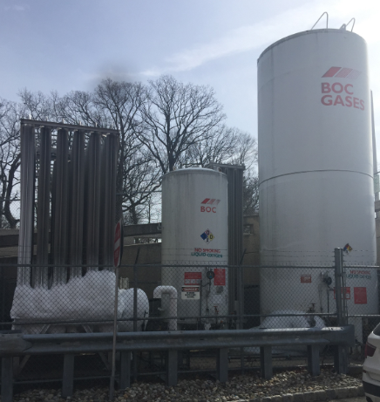
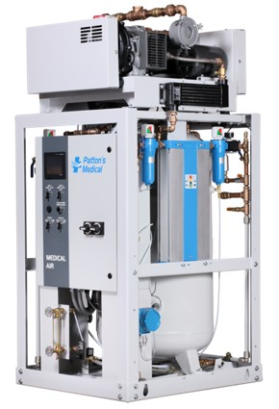
3.3.108 Medical Gas System. An assembly of equipment and piping for the distribution of non-flammable medical gases such as oxygen, nitrous oxide, compressed air, carbon dioxide, and helium.

Slide 7
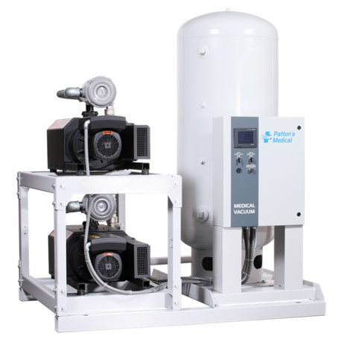
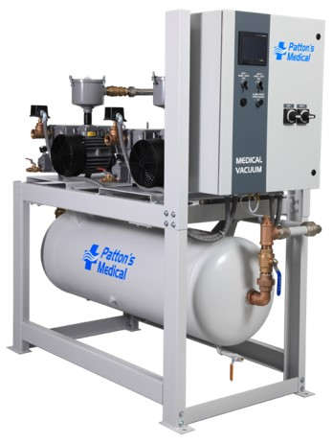
3.3.111 Medical-Surgical Vacuum System. An assembly of central vacuum-producing equipment and a network of piping for patient suction in medical, medical-surgical, and waste anesthetic gas disposal applications.

Slide 8
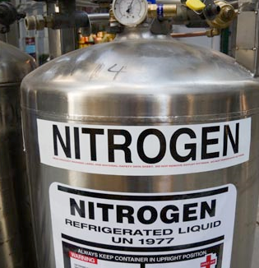
3.3.109 Medical Support Gas. Nitrogen or instrument air used for any medical support purpose and, if appropriate to the procedures, used in laboratories and are not respired as part of any treatment.
Examples: drying instruments, operate medical-surgical tools, air driven booms, or pendants

Slide 9
5.1.14.2 Maintenance of Medical Gas, Vacuum, WAGD, and Medical Support Gas Systems.
5.1.14.2.2 Maintenance Programs.
5.1.14.2.2.1 Inventories. Inventories of medical gas, vacuum, WAGD, and support gas systems shall include at least all source subsystems, control valves, alarms, manufactured assemblies containing patient gases, and outlets.

Slide 10
5.1.14.2.2.2* Inspection Schedules. Scheduled inspections for equipment and procedures shall be established through the risk assessment of the facility and developed with consideration of the original equipment manufacturer recommendations and other recommendations as required by the authority having jurisdiction.
Chapter 3 Definition
3.2.2* Authority Having Jurisdiction (AHJ). An organization, office, or individual responsible for enforcing the requirements of a code or standard, or for approving equipment, materials, and installation, or a procedure

Slide 11
5.1.14.2.2.3 Inspection Procedures. The facility shall be permitted to use any inspection procedure (s) or testing methods established through its own risk assessment.

Slide 12
5.1.14.2.2.4 Maintenance Schedules. Scheduled maintenance for equipment and procedures shall be established through the risk assessment of the facility and developed with consideration of the original equipment manufacturer recommendations and any other recommendations as required by the authority having jurisdiction.

Slide 13
5.1.14.2.2.4 Maintenance Schedule
Example showing why the risk assessment is essential
Manufacturer Says: Change Oil Every 500 hours
System runs 12 hours per day (there are two pumps alternating so each run 6 hours per day)
Oil should be changed every 83 days
The service contract is for quarterly preventive maintenance

Slide 14
5.1.14.2.2.5 Qualifications. Persons maintaining these systems shall be qualified to perform these operations. Appropriate qualification shall be demonstrated by any of the following:

Slide 15
(1) Training and certification through the healthcare facility by which such persons are employed to work with specific equipment as installed in that facility

Slide 16
(2) Credentialing to the requirements of ASSE 6040, Professional Qualification Standard for Medical Gas Maintenance Personnel
Candidates must be employed or contracted by a health care facility, or actively engaged in working with medical gas systems.
Candidate shall have minimum of one (1) year of documented practical experience in the maintenance of medical gas systems.
Candidate shall have completed a minimum 32-hour training course conducted by a Medical Gas Systems Instructor certified to ASSE Standard 6050

Slide 17
(3) Credentialing to the requirements of ASSE 6030, Professional Qualification Standard for Medical Gas System Verifiers
Candidates must have a minimum of two (2) years of documented practical experience in the verification of medical gas piping systems. Records substantiating the required experience or testimonial letters on company letterhead from employers are required. Testimonial letters must fully describe duties performed and dates employed, and must be accompanied by W-2 forms.
Candidates are also required to have a current certificate of insurance, in the name of the individual or employing verification company, for general liability, and professional liability insurance.
Candidate shall have completed a minimum 32-hour training course conducted by a Medical Gas Systems Instructor certified to ASSE Standard 6050

Slide 18
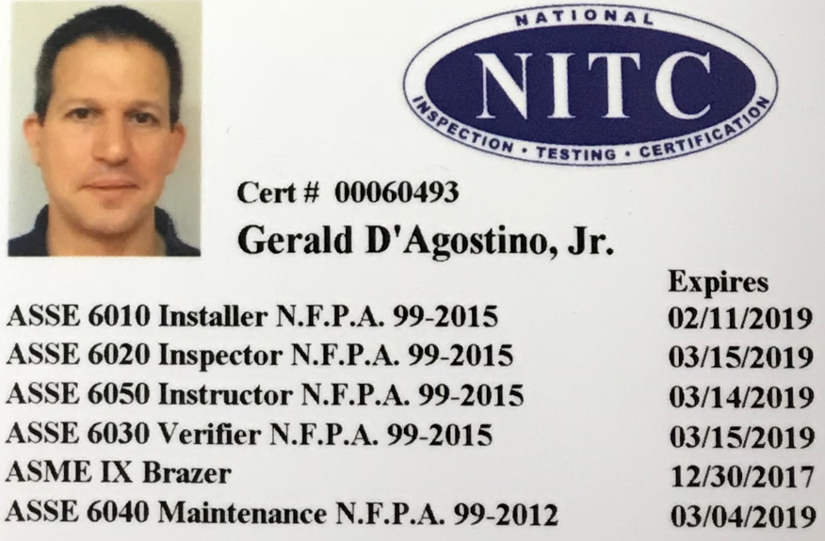
Credentials

Slide 19
5.1.14.2.3 Inspection and Testing Operations
5.1.14.2.3.1 General. The elements in 5.1.14.2.2.2 through 5.1.15 shall be inspected or tested as part of the maintenance program as follows:

Slide 20
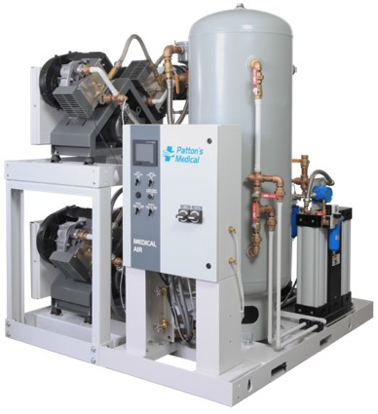
Medical air source, as follows:
A. Room temperature
B. Shaft seal condition
C. Filter condition
D. Presence of hydrocarbons
E. Room ventilation
F. Water quality, if so equipped
G. Intake location
H. Carbon monoxide monitor calibration
I. Air purity
J. Dew point

Slide 21
Medical Vacuum Source-Exhaust Location
WAGD Source-Exhaust Location
Instrument Air Source-Filter Condition

Slide 22
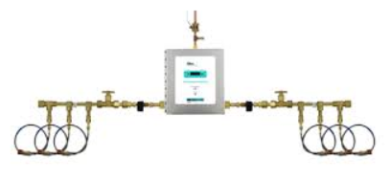
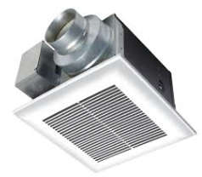
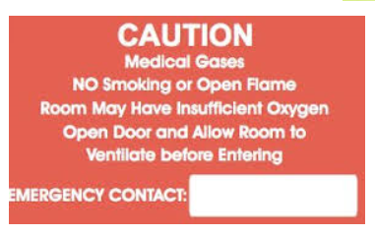
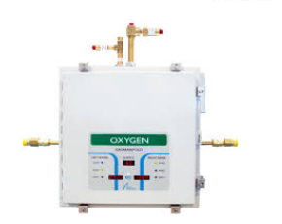
Manifold Sources
(a) Ventilation
(b) Enclosure Labeling
1ft AFF

Slide 23
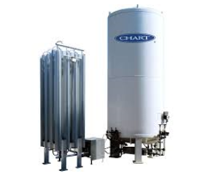
Bulk cryogenic liquid source-inspected in accordance with NFPA 55, Compressed Gases and Cryogenic Fluids Code
NFPA 55
8.14.1.3 (NFPA 55) Inspection
8.14.1.3.1 (NFPA 55) Cryogenic fluid storage systems shall be inspected annually and maintained by a qualified representative of the equipment owner.
8.14.1.3.2 (NFPA 55) A record of the inspection shall be prepared and provided to the user or the authority having jurisdiction upon request.

Slide 24
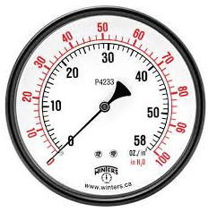
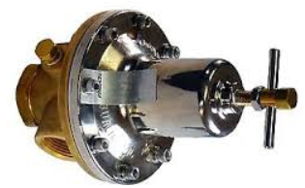
Final line regulation for all positive pressure systems-
Delivery pressure

Slide 25
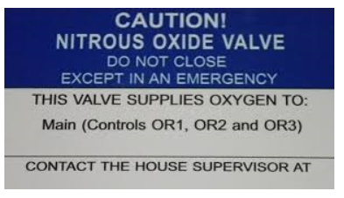
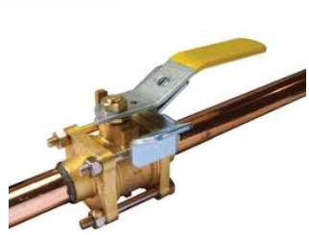
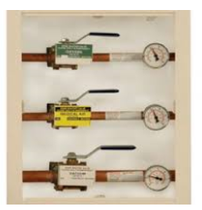
Valves-Labeling

Slide 26
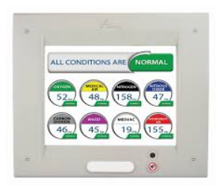
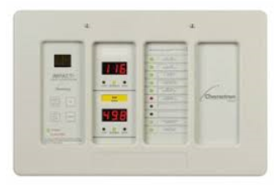
Alarms and Warning Systems-Lamp and Audio Operation

Slide 27
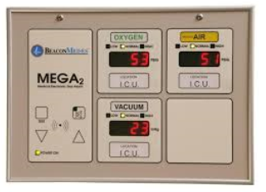
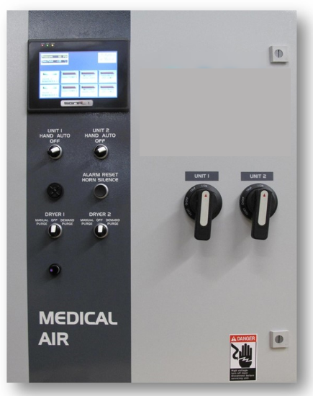
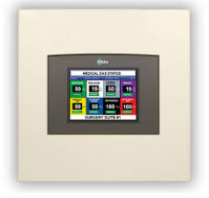
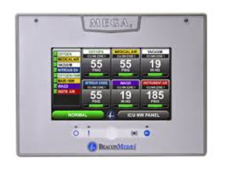
Alarms and Warning Systems, as follows:
(a) Master alarm signal operation
(b) Area alarm signal operation
(c) local alarm signal operation

Slide 28
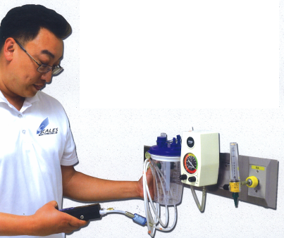
Station outlets/inlets, as follows:
(a) Flow
(b) Labeling
(c) Latching/de-latching
(d) Leaks

Slide 29
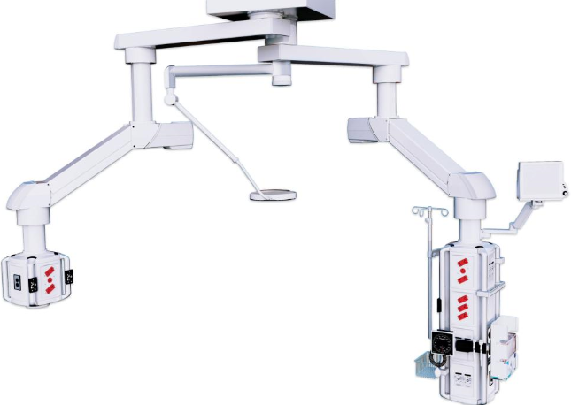
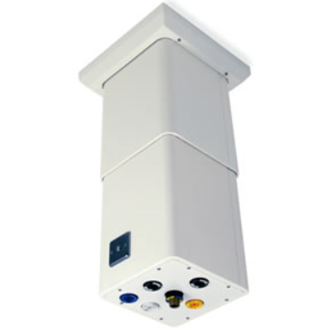
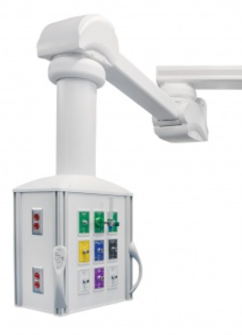
5.1.14.2.3.2 Manufactured Assemblies Employing Flexible Connection (s) Between the User Terminal and the Piping System.
Nonstationary booms and articulating assemblies, other than headwalls utilizing flexible connectors, shall be tested for leaks, per manufacturer’s recommendations, every 18 months, or at a duration that is safe for use with oxygen.
The system pressure to nonstationary booms and articulating arms shall be maintained at operating pressure until each joint has been examined for leakage by effective means of leak detection that is safe with oxygen

Slide 30
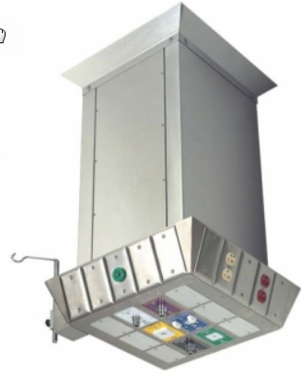
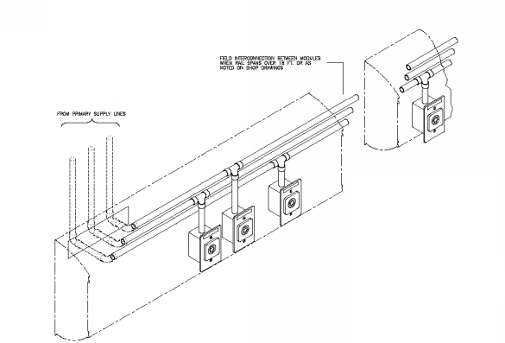
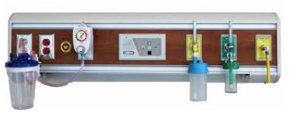
5.1.14.2.3.2 Manufactured Assemblies Employing Flexible Connection (s) Between the User Terminal and the Piping System.-CONTINUED
Safe working condition of the flexible assemblies shall be confirmed.
DISS connectors internal to the boom and assemblies shall be checked for leakage
Leaks, if any, shall be repaired, or the components replaced, and the equipment retested prior to placing the equipment back into service
Additional testing of nonstationary booms or articulating arms shall be performed at intervals defined by documented performance data.

Slide 31
5.1.14.3 Medical Gas and Vacuum Systems Information and Warning Signs.
5.1.14.3.1 The gas content of medical gas and vacuum piping systems shall be labeled in accordance with 5.1.11.1
5.1.14.3.2 Labels for shutoff valves shall be in accordance with 5.1.11.2 and updated when modifications are made changing the areas served.

Slide 32
5.1.14.4 Medical Gas and Vacuum Systems Maintenance and Record Keeping.
5.1.14.4.1 Permanent records of all tests required by 5.1.12.3.1 through 5.1.12.3.14 shall be maintained in the organization’s files.
5.1.14.4.2 The supplier of the bulk cryogenic liquid system shall, upon request, provide documentation of vaporizer (2) sizing criteria to the facility.

Slide 33
5.1.14.4.3 An annual review of bulk system capacity shall be conducted to ensure the source system has sufficient capacity.
5.1.14.4.4 Central supply systems for nonflammable medical gases shall conform to the following:
(1) The shall be inspected annually
(2) They shall be maintained by a qualified representative of the equipment owner.
(3) A record of the annual inspection shall be available for review by the authority having jurisdiction

Slide 34
5.1.14.4.5 A periodic testing procedure for nonflammable medical gas and vacuum and related alarm systems shall be implemented.

Slide 35
5.1.14.4.6 Whenever modifications are made that breach the pipeline, any necessary installer and verification test specified in 5.1.12 shall be conducted on the downstream portions of the medical gas piping system.

Slide 36
5.1.14.4.7 Procedures, as specified, shall be established for the following:
(1) Maintenance program for the medical air compressor supply system in accordance with the manufacturer’s recommendations
(2) Facility testing and calibration procedure that ensures carbon monoxide monitors are calibrated at least annually or more often if recommended by the manufacturer
(3) Maintenance program for both the medical-surgical vacuum piping system and the secondary equipment attached to the medical-surgical vacuum station inlets to ensure the continued good performance of the entire medical-surgical vacuum system

Slide 37
5.1.14.4.8 Audible and visual alarm indicators shall meet the following requirements:
(1) They shall be periodically tested to determine that they are functioning properly.
(2) Records of the test shall be maintained until the next test is performed.

Slide 38
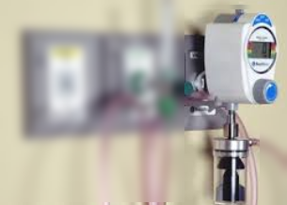
5.1.14.4.9 Medical-surgical vacuum station inlet terminal performance, as required in 5.1.12.3.10.4, shall be tested as follows:
(1) On a regular preventive maintenance schedule as determined by the facility maintenance staff
(2) Based on flow of free air into station inlet while simultaneously checking the vacuum level

Slide 39
5.1.15 Category 1 Maintenance. Facilities shall have a routine maintenance program for their piped medical gas and vacuum systems.

Slide 40
Thank you
Contact me anytime:
Jay D’Agostino
Business Development Manager
cell: 516.521.5649
email: jay@scalesmedtech.com
website: www.scalesmedtech.com

