Slide 1
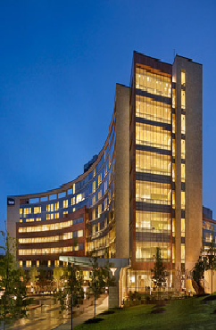
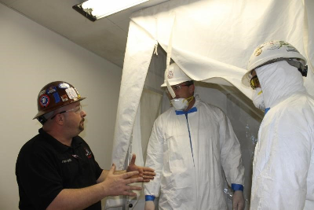
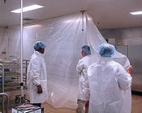
Health Facilities Design: What’s New, What’s Coming
David B.Uhaze, RA
Health Facilities Design Consulting
Vice Chairman – FGI Health Guidelines Revision Committee
Retired Chief - Bureau of
Construction Project Review
NJ Dept. Of Community Affairs
Health Facilities Management
Society of New Jersey
November 17, 2016

Slide 2
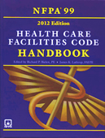
Introduction
Bureau of Construction Project Review
E-Plan Review
Guidelines for Design and Construction of Hospitals and Outpatient Facilities
2012 NFPA 101 & 99
International Codes Council
NJ State Legislature PL2015 Chap. 168

Slide 3
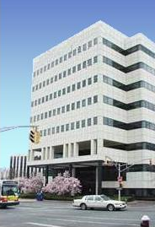
DCA – Bureau of Construction Project Review
The Bureau
Functions as the construction office for all building projects reserved to the State at NJAC 5:23-3.11
This includes such projects as:
Healthcare Facilities
Casinos
State Buildings (State colleges, NJTPA, NJT, NJSEA, etc.)
Special Projects (Electrical Gen., Solid Waste Treatment, etc.)
Prototypes (Big box stores, banks, etc.)
Schools
Performs both a UCC and Licensing review on all projects submitted
Will comment on Licensing requirements, but cannot grant waivers to those requirements

Slide 4
DCA – Bureau of Construction Project Review
Electronic submission of plans became mandatory Jan. 1, 2016
The Department of Community Affairs now does all of the following electronically:
Accept project applications
Review Plans
Issue Releases
Collect electronic Payments
eCheck
Credit Card
All of this is being done through an on line system called
ProjectDox by

Slide 5
DCA – Bureau of Construction Project Review
Avolve – ProjectDox is a Web hosted, secure site with a fully Automated review process that provides Automatic notifications, complete project tracking and extensive Project archiving

Slide 6
DCA – Bureau of Construction Project Review
http://www.state.nj.us/dca/divisions/codes/offices/ePlans.html
ePlans User Guide
ePlans Login Page
ePlans FAQs
DCA is offering Webinars for those interested in learning more about the system December 10th: 10:00am - 11:00am
Technical question regarding electronic submission should be directed to the DCA Help Desk at (609) 292-8134 or helpdesk@dca.nj.gov

Slide 7
DCA – Bureau of Construction Project Review
Health Care Plan Review Timeline
20 day review cycle for new projects with complete applications (currently closer to 40/45 days)
7 day review cycle for re-submitted projects (currently closer to 20 days)
Permitting and inspections are done at the local level
May grant permission for a local review of certain
projects

Slide 8
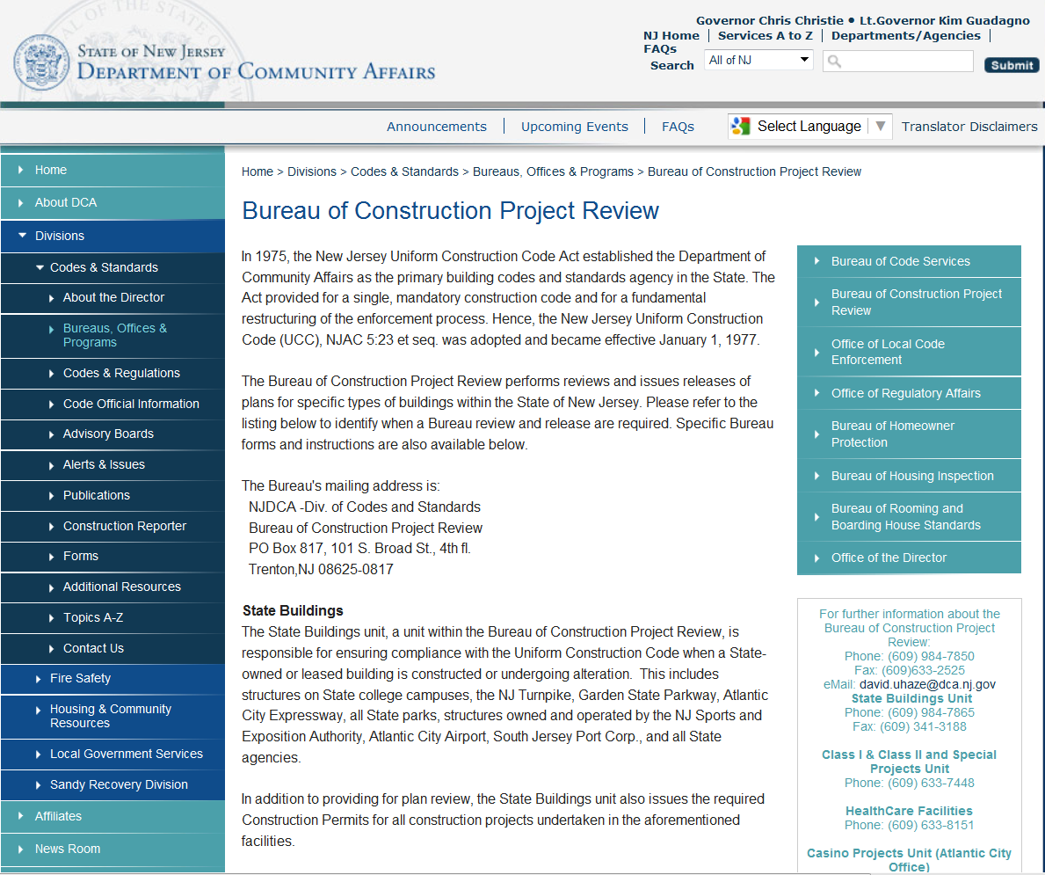
DCA – Bureau of Construction Project Review
You can find additional information about the Bureau including:
Bureau mailing addresses and phone numbers, a listing of
when a Bureau review and release is required, answers to frequently asked questions about the plan review and release process, the Procedures for Submission to Health Care Plan Review & E-Plan Review Procedures manuals
and
you can access all of the necessary forms for submission at the
Bureau’s website:
www.state.nj.us/dca/divisions/codes/offices/bcpr.html

Slide 9
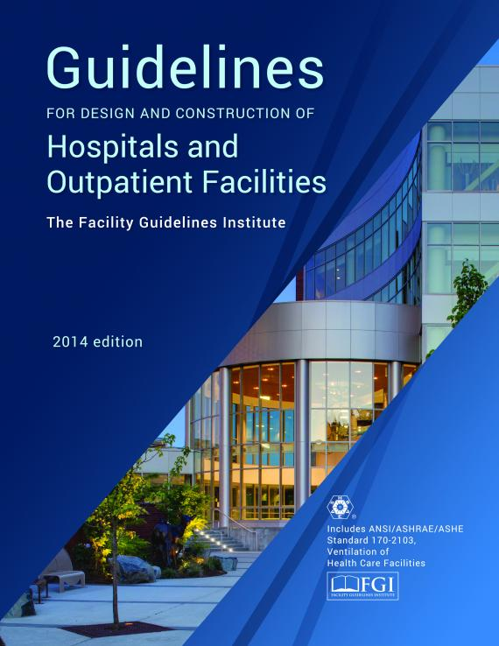
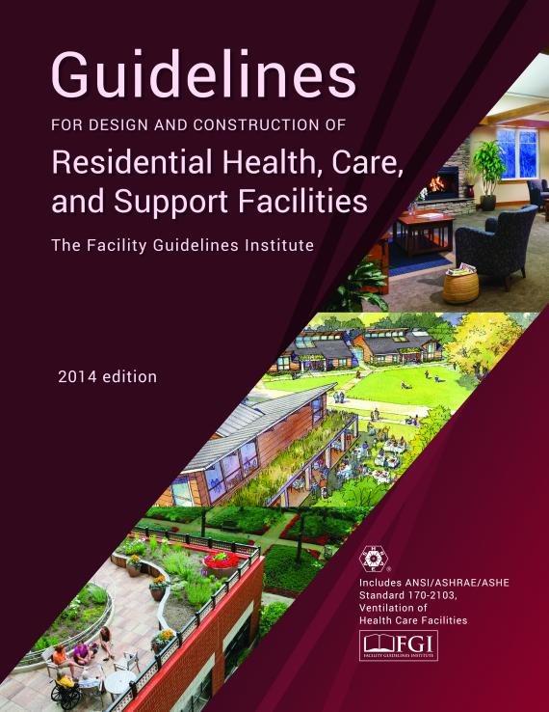
The FGI Guidelines 2014
The Hospital and Outpatient Facilities edition
and the Residential Health, Care, and Support Facilities edition
have been in use by the NJDOH and NJDCA since August 1, 2014

Slide 10
The FGI Guidelines 2014
2 Separate Volumes:
Guidelines for Design and Construction of Hospitals and Outpatient Facilities
Includes Chapters 1, 2, 3 & 5 (except for Medical Day Care)
Guidelines for Design and Construction of Residential Health, Care, and Support Facilities
Includes Chapters 1 & 4 (plus Medical Day Care)
Both volumes
Include former Chapter 6 ASHRAE/ASHE 170

Slide 11
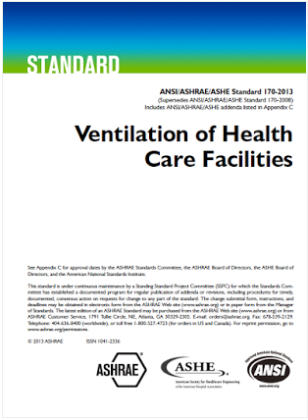
ASHRAE/ASHE 170
FGI continues to work with ASHRAE and ASHE to revise and update this standard.
FGI members are included in the 170 committee
170 is under a continuous maintenance process, which permits official changes to be made over the life cycle of the document.
The 2013 edition of ASHRAE/ASHE 170, with all addenda approved through November 2013, was incorporated as Part 4 of the 2014 edition of the FGI Guidelines.

Slide 12
The FGI Guidelines 2014
Interpretations:
Hospital & Outpatient
http://www.fgiguidelines.org/wp-content/uploads/2016/10/FGI_interps_Guuidelines_2014_HOP_161013.pdf
AHSRAE 170 Interps
http://www.ashrae.org/standards-research--technology/standards-interpretation/interpretations-for-standard-170-2013

Slide 13
The FGI Guidelines Process

Slide 14
The FGI Guidelines Process

Slide 15
The FGI Guidelines 2018
At the end of the 2014 Cycle, the FGI Board undertook two Colloquiums focused on the future of Healthcare and the Guidelines.
These colloquiums brought together a diverse group of healthcare futurists who were tasked with envisioning the range of healthcare environments and trends that may emerge by the year 2026 and to help FGI lay out a roadmap of the steps that we need to take to stay relevant over that time period.

Slide 16
The FGI Guidelines 2018
The panel noted that :
Healthcare organizations are struggling to manage/reduce costs while working to improving clinical quality and the patient experience
That they will continue to face challenges such as:
Evolving healthcare reform
Shifting reimbursement policies
An aging population
An explosion in demand from newly insured patients
New information technologies
And the pursuit of new models of healthcare over the coming years.
Hospitals and other healthcare facilities will, of necessity, be forced to rethink their planning, design, and operations

Slide 17
The FGI Guidelines 2018
The first thing recommended to FGI, was that the Guidelines documents should be split into two parts:
Fundamental Requirements
Beyond Fundamentals

Slide 18
The FGI Guidelines 2018
The Fundamentals Documents would include only those requirements that are deemed essential to provide safe, effective, cost efficient care environments.
These would be baseline requirements that meet the needs of the patients and staff without compromising quality outcomes & safety and have been proven to be cost effective
Evidence based
Cost/Benefit balanced

Slide 19
The FGI Guidelines 2018
The Beyond Fundamental Documents would include those items which constitute forward thinking, advanced concepts and practices which exceed basic requirements and which encourage design innovation.
Much of this information is included in the appendix sections of the current Guidelines documents and in other Guidelines supporting documents ie: white papers, research studies, etc.

Slide 20
The FGI Guidelines 2018
The second recommendation was to have the FGI Health Guidelines Revisions Committee focus the bulk of their work on Primary Care/Outpatient Facilities for the coming revision cycle, as the trend in health care delivery continues to move in that direction.

Slide 21
The FGI Guidelines 2018
Based on those recommendations and with FGI’s intent to more clearly differentiate the needs of each facility type, at the conclusion of the 2018 Cycle the following documents will be published:
Hospital Fundamentals
Outpatient Fundamentals
Residential Fundamentals
And, in a yet to be determined form, the following will also be published:
Hospital Beyond Fundamentals
Outpatient Beyond Fundamentals
Residential Handbook

Slide 22
The FGI Guidelines 2018
Each of the documents will be:
A separate stand-alone document.
Will be independent from the other documents and will not contain references back to any of the other documents.
Each Document will be in the same basic format as the 2014 Guidelines, with modifications as necessary.

Slide 23
The FGI Guidelines 2018
New Outpatient Document
The New Outpatient Document will, at a minimum, cover of the ambulatory categories that are currently addressed in the 2014 Hospital & Outpatient Guidelines
and
May include additional categories and information if deemed necessary by the Outpatient Document group.

Slide 24
The FGI Guidelines 2018
The following are some of the changes proposed for the 2018 FGI Guidelines documents:
Hospitals & Outpatient Facilities
New guidance on design of telemedicine spaces
New design requirements for accommodations for care of “patients of size”, to include those who are not necessarily obese, such as very tall people
Clarification of procedure room and operating room requirements: procedure types, facility types, hybrid ORs
New classification structure based on procedures performed and patient acuity for determining imaging room requirements

Slide 25
The FGI Guidelines 2018
Hospitals & Outpatient Facilities cont.
New flexibility in pre- and post-procedure patient care area design requirements
Two options for sterile processing area design: two required rooms (decontamination and clean) with an exception for a single room for small tabletop sterilizers
New design requirements for a sexual assault forensic examination room
Revised mobile/transportable medical unit chapter
Updated acoustics requirements
Expanded sustainability requirements re: waste minimization, potable water, and energy efficiency
Revised guidance for emergency preparedness and management (formerly provisions for disasters)

Slide 26
The FGI Guidelines 2018
Residential Health, Care and Support Facilities
Updated acoustics and lighting requirements
Updated minimum requirements for grab bar configurations to align with the latest research
New chapter on settings for individuals with intellectual and/or developmental disabilities
New chapter on long-term residential substance abuse treatment facilities
New telemedicine section to address the increasing provision of telemedicine services in residential facilities
Language shift from “bariatric resident” to “person of size” since people who need accommodations include those who are not necessarily obese, such as very tall people

Slide 27
The FGI Guidelines 2018
The Second public comment period for commenting on these code changes began on September 29, 2016 and will close on December 12, 2016.
Comments may be made only on proposed changes to the text (deletions, revisions, or new material) in the draft 2018 FGI Guidelines
Commenters are asked to provide their take on the costs and benefits of any changes they submit, using a cost/benefit comment box and a cost/benefit matrix provided in the comment systems.

Slide 28
The FGI Guidelines 2018
Operating room (OR) ceilings
Because there is so much equipment installed in OR ceilings today, true “monolithic” ceilings, which have been a Guidelines requirement for more than a decade, do not really exist.
The HGRC has debated whether it makes sense to allow use of lay-in ceilings in ORs in the future.
The lay-in ceilings would have to be of cleanroom quality and gasketed with smooth tiles installed in a manner to prevent particles from above from penetrating the ceiling assembly and contaminating the surgical site.
FGI is interested in hearing from the industry about this requirement and whether it should be changed.

Slide 29
The FGI Guidelines 2018
Definitions for percutaneous and invasive procedures
Percutaneous procedure: A procedure during which the skin is penetrated by a needle puncture or an incision that goes no deeper than the skin or subcutaneous space and may involve introduction of wires and catheters and/or insertion of an indwelling foreign body (temporary or permanent).
Note: An example is a procedure in which a needle is used to puncture the structure and a guide wire is threaded through the needle; when the needle is withdrawn, a catheter is threaded over the wire. The wire is then withdrawn, leaving the catheter in place.

Slide 30
The FGI Guidelines 2018
Invasive procedure: A procedure that is performed in an aseptic surgical field and penetrates the protective surfaces of a patient’s body (e.g., skin, mucous membranes, cornea). An invasive procedure may fall into one or more of the following categories:
Requires entry into or opening of a sterile body cavity (e.g., cranium, chest, abdomen, pelvis, joint spaces);
Involves insertion of an indwelling foreign body (temporary or permanent);
Includes excision and grafting of burns that cover more than 20 percent of total body area; or
Does not begin as an open procedure but has a measurable risk of requiring emergency conversion to an open procedure.

Slide 31
The FGI Guidelines
To help users of the FGI Guidelines learn more about the current Guidelines and other editions of the standard, the Facility Guidelines Institute is producing a series of articles on changes and new material
Visit this page to the articles:
http://www.fgiguidelines.org/resources-category/resources-associated-with-the-fgi-guidelines/

Slide 32
National Fire Protection Association 2012 Codes
Life Safety Code 101
Health Care Facilities Code 99
The Centers for Medicare & Medicaid Services (CMS) adopted by regulation the 2012 LSC and the 2012 HCFC effective July 5, 2016.
CMS will began surveying for compliance with the 2012 LSC and HCFC on November 1, 2016.

Slide 33
National Fire Protection Association 2012 Life Safety Code
Allows existing openings in exit enclosures to mechanical equipment spaces protected by fire-rated door assemblies. These spaces must be used only for non-fuel-fired equipment, must contain no storage of combustible materials, and must be located in sprinklered buildings.
Allows new sleeping suites up to 10,000 square feet .
Allows one of the required means of egress from sleeping and non-sleeping suites to be through another suite, provided adequate separation exists between suites and one of the two required exit access doors from sleeping and non-sleeping suites is into an exit stair, exit passageway, or to the exterior.

Slide 34
National Fire Protection Association 2012 Life Safety Code
Allows more than one delayed-egress lock in the egress path
Allows door locking where justified by clinical needs, patients pose a security risk, or where patients require specialized protective measures for their safety
Allows an increase in the size of containers used solely for recycling clean waste or for patient records awaiting destruction outside of a hazardous storage area to be a maximum of 96-gallons
Allows a testing interval of 6 years rather than 4 years for the maintenance testing of fire and smoke dampers

Slide 35
National Fire Protection Association 2012 Life Safety Code
Allows for the reduction in the testing frequencies for sprinkler system vane-type and pressure switch type waterflow alarm devices to semiannual, and electric motor-driven pump assemblies to monthly.
Allows for a reduction in the annual diesel-powered generator exercising requirement from two (2) continuous hours to one hour and 30 minutes (1-1/2 continuous hours)
Allows for the use of power strips in existing and new health care facility patient care areas/rooms, if they comply with all applicable 2012 NFPA 99 power strip requirements

Slide 36
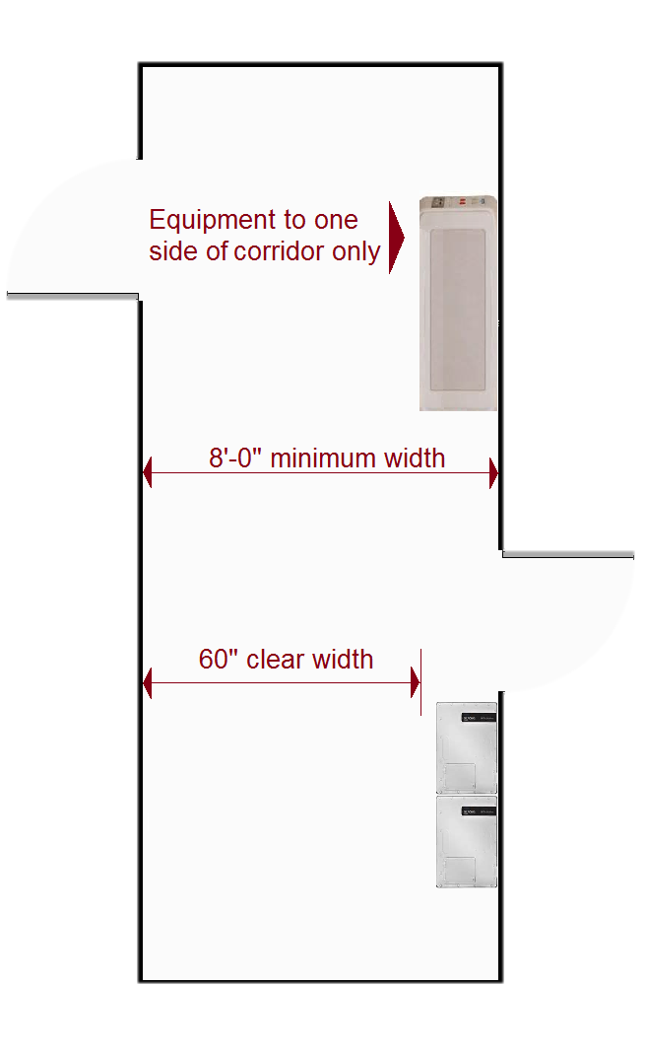
National Fire Protection Association 2012 Life Safety Code
Equipment will be allowed to be kept in corridors that are a minimum of 8’-0” in width and as long as 60” of clear with is maintained. This will include in-use carts (laundry, food service, housekeeping), emergency equipment and portable lifts.
Furnishings (tables, chairs and other seating) will be allowed on one side of corridors that are a minimum of 8’-0” in width and as long as 60” of clear width is maintained. Each furniture location is limited to 50sf or less and furniture locations must be separated by a minimum of 10ft.

Slide 37
NFPA 99 – Health Care Facilities Code 2012 Edition
Allows Hospitals and Critical Access Hospitals with new and existing ventilation systems supplying anesthetizing locations, to operate with a Relative Humidity level of ≥ 20 percent. CMS still strongly recommends that facilities maintain RH in a range of ≥20 – ≤60 percent in all anesthetizing locations.
Allows a centralized computer system to substitute for one of the Category 1 medical gas master alarms, as long as the provider/supplier is in compliance with section 5.1.9.4 of NFPA 99 2012.

Slide 38
International Codes Council
Ad Hoc Committee on Healthcare
The objective of this committee is to develop code change proposals which will result in the most contemporary and efficient provisions for hospital and ambulatory care facilities.
Most of the work that they are doing is to bring the IBC in line with the requirements already in place in the LSC
They look at 4 different areas throughout the code with regard to requirements for health care facilities :
Means of Egress
Fire/Life Safety
General Code Requirements
Occupancy

Slide 39
NJ State Legislature
P.L.2015, CHAPTER 168 - effective June 1, 2016
Requires a nursing home, assisted living facility, comprehensive personal care home, pediatric community transitional home, federally qualified health center, dialysis center, hospice in-patient care, or a residential health care facility connected to another licensed facility to be equipped with generators.

Slide 40
NJ State Legislature
Within one year of the effective date of this act, a facility shall:
Be equipped with an electrical transfer switch and wiring that complies with applicable standards administered by the Health Care Plan Review Unit and have a signed contract to have a generator delivered to the facility in the event of a power outage that:
Can be connected to the electrical transfer switch;
Provides backup electrical power
Complies with applicable standards administered by the Health Care Plan Review Unit;

Slide 41
NJ State Legislature
or
Shall have a signed contract to have an on-site generator installed at the facility within three years of the effective date of this act that:
Provides backup electrical power in the event of a power outage; and
Complies with applicable standards administered by the Health Care Plan Review Unit.
The generator or generator connection shall be capable of supporting the following for a minimum of 48 hours:
Critical life support equipment;
Refrigeration for medications and at least one refrigerator for perishable food;
Lighting for means of egress, exit signs, and exit directional signs as required by the NFPA 101, Life Safety Code 2012 Edition

Slide 42
NJ State Legislature
Cont.
Emergency lighting in common areas;
Equipment necessary for maintaining back-up communications
Elevator service if required for the relocation of patients or residents within the facility or evacuation from the facility;
A fire pump, well pump, or sump pump, if installed;
A sewerage pump, if installed;
Fire, smoke and other safety detection alarm systems; and
Emergency lighting and power required for the generator at the generator connection point.

Slide 43
Where To Get More Information:
FGI Guidelines
1.800.242.2626
www.ashestore.com
NJ Uniform Construction Code & Uniform Fire Code
609.984.0040
www.nj.gov/dca/codes/forms/pubsandsubs.htm
International Codes
1.800.786.4452
order@iccsafe.org
National Fire Protection Association
1.800.344.3555
www.custserv@nfpa.org

Slide 44
David B. Uhaze, RA
Health Facilities Design Consulting
Providing consultation and guidance with regard to
Building Codes & FGI Guidelines requirements for health care facilities
609-516-8978
dbuhaze@optonline.net

