Slide 1
2017 Updates
George Mills, Director Department of Engineering

Slide 2
EC.02.06.01 EP 1
Interior spaces meet the needs of the patient population and are safe and suitable to the care, treatment and services provided.
Ligature/self harm risks (i.e. BHC)
Current Risk Assessment
Best Practice Guidelines
Design Guide for the Built Environment of Behavioral Health Facilities

Slide 3
Ligature Risks – Psychiatric Settings
Inpatient and Designated Non-behavioral settings for treatment
Ligature and self-harm risks identified and eliminated
Corrections in process OK if
Policies and procedures developed & implemented
See also Joint Commission Online, May 24, 2017
www.jointcommission.org/issues

Slide 4
Ligature Risks – Psychiatric Settings
Process: self-harm risks identified
Determination if previously identified
Evaluate existing plans for removing the risks
Evaluate the environmental risk assessment process
See also Joint Commission Online, May 24, 2017
www.jointcommission.org/issues

Slide 5
Ligature Risks – Psychiatric Settings
Further evaluation
Plans and policies on mitigation of harm posed by risks while removal occurs
Adequacy of staffing patterns to the mitigation plans
The patient suicide risk assessment process
See also Joint Commission Online, May 24, 2017
www.jointcommission.org/issues

Slide 6
Ligature Risks – Psychiatric Settings
Further evaluation
Policies and practices related to actions needed for patients identified at risk
Policies and processes of ensuring staff awareness of a patient’s level of risk
The organization’s internal processes for improvement, including:
The history of patient safety events and the process for root cause analysis of these events
The organization’s process for monitoring its compliance with its policies
Actions taken when noncompliance was identified

Slide 7
Ligature Risks – Non Behavioral Settings
Not designated
Temporary location for psychiatric patient
Ligature/self-harm issues must be identified
Remove physical risks not required for treatment
If able
Implement surveillance if risks remain
P&Ps adequately guide staff in assessment
Implement measures based on patient needs
See also Joint Commission Online, May 24, 2017
www.jointcommission.org/issues

Slide 8
EC.02.03.03 EP 3
When quarterly fire drills are required, at least 50% are unannounced. Fire drills are held at unexpected times and under varying conditions.
Minimum one hour between times completed
No pattern

Slide 9
EC.02.03.05 EP 25
The hospital has written documentation of annual inspection and testing of door assemblies by individuals who can demonstrate knowledge and understanding of the operating components of the door being tested. Testing begins with a pre-test visual inspection; testing includes both sides of the opening.
Note: For additional guidance on testing of door assemblies, see NFPA 101-2012: 7.2.1.5.10.1; 7.2.1.5.11; NFPA 80-2010: 4.8.4; 5.2.1; 5.2.3; 5.2.4; 5.2.6; 5.2.7; 6.3.1.7; NFPA 105-2010: 5.2.1.

Slide 10
Door Inspections
Required for all fire and smoke barrier doors
Corridor doors not required if not part of fire or smoke barrier
Complete by July 5, 2017
Based on NFPA 101-2012, 7.2.1.15
Beneficial to ongoing reliability

Slide 11
Door Inspections
Doors to be included in the annual door inspection (based on 7.2.1.15) include:
Door leaves equipped with panic hardware or fire exit hardware in accordance with 7.2.1.7
Door assemblies in exit enclosures
Electrically controlled egress doors
Door assemblies with special locking arrangements subject to 7.2.1.6

Slide 12
Door Inspections
The Joint Commission does not require the following doors to be included in the annual door inspection:
Corridor doors (i.e., patient room doors)
Office doors (provided the room does not contain flammable or combustible materials)

Slide 13
Fire Doors Installed Where Not Required
NFPA 101-2012, 4.6.12.3
Existing fire protection features obvious to the public, if not required by the Code, shall be either maintained or removed.
Doors shall be maintained per the barrier assembly requirements
See also EC.02.03.05, EP 25 and LS.01.01.01, EP 6

Slide 14
Fire Doors Installed Where Not Required
Fire-rated doors in a nonrated barrier assembly
Must be maintained as a fire door unless the features which identify it as a fire door have been removed in a manner that maintains the opening protective requirements applicable to the barrier into which it is installed.

Slide 15
LS.02.01.10 EP 1: ED Occupancy
Health Care
Facilities that provide sleeping accommodations for persons who are mostly incapable of self-preservation, or that provide housing on a 24-hour basis for occupants, are classified as health care occupancies, per National Fire Protection Association (NFPA) 101-2012, 18/19.1.1.1.5 and 18/19.1.1.1.9.
See also Joint Commission Online, May 24, 2017
www.jointcommission.org/issues

Slide 16
LS.03.01.10 EP 1: ED Occupancy
Ambulatory Health Care
Used to provide services or treatment simultaneously to four or more patients that provides, on an outpatient basis, one or more of the following:
Treatment for patients that renders the patients incapable of taking action for self-preservation under emergency conditions without the assistance of others
Anesthesia that renders the patients incapable of taking action for self-preservation under emergency conditions without the assistance of others

Slide 17
LS.03.01.10 EP 1: ED Occupancy
Ambulatory Health Care
Used to provide services or treatment simultaneously to four or more patients that provides, on an outpatient basis, one or more of the following:
Emergency or urgent care for patients who, due to the nature of their injury or illness, are incapable of taking action for self-preservation under emergency conditions without the assistance of others.
See also Joint Commission Online, May 24, 2017
www.jointcommission.org/issues

Slide 19
Leadership Vision
Develop one single, comprehensive method of categorizing the risk associated with standards
Notes:
Develop one single, comprehensive method of categorizing the “risk” associated with standards that will work for all purposes (from post-survey follow-up, accreditation decisions, to intra-cycle touchpoints, etc.).
Recognize that the potential for a standard to be related to a risk/safety issue depends on the context of the situation during a given survey, and not just on a pre-determined tag.

Slide 20
Project Overview
Address customer concerns
Address contemporary issues in our standards
Reduce complexity
Streamline manual
Hospital program
Occurring in phases
Did not affect Elements of Performance (EPs) directly related to Medicare Requirements (CoPs)

Slide 21
Survey Analysis For Evaluating Risk (SAFER) Matrix & Post-Survey Follow-up
For more information see January 2017 Perspectives

Slide 22
A New SAFER Model
 |  | Immediate Threat to Life (follows current ITL processes)
Likelihood to Harm a Patient/Visitor/Staff | HIGH
 | MODERATE
 | LOW
 |  | LIMITED | PATTERN | WIDESPREAD
17

Slide 23
How is Risk Determined?
Operational definitions and “anchors”
Surveyor experience and expertise will provide the support to determine the “scope” and “likelihood to harm” for the finding
Based on the context of the finding
Discussion amongst the survey team

Slide 24
Customer Impacts as of 1/1/2017
No more Direct and Indirect EP designations
All ESC now 60-day time frame
Consolidated Evidence of Standards Compliance (ESC) into one time frame
No more Measures of Success (MOS)
No more Opportunities for Improvement (OFIs)
See it / Cite it Survey Methodology
No more ‘A’ or ‘C’ categories

Slide 25
Reducing Post-Survey Clarifications

Slide 26
What is Clarification?
“After a survey event, organizations have the opportunity to submit clarifying ESC if they believe that their organization was in compliance with a particular standard at the time of Survey.”
ACC-60

Slide 27
Hospital Clarifications
In 2016
50% of Hospital Accreditation Programs (HAP) request Clarifications
51% of HAP Clarifications are in the Environment of Care (EC) and Life Safety (LS) Chapters
Dominant clarification themes:
Lack of Documentation (65%)
Incorrect Findings
Survey Process Issues

Slide 28
Documentation
Embedded in the EPs is the icon
NFPA* requires documentation be available “UPON REQUEST”
*See NFPA 25-2011 4.3 and NFPA 72-2012 14.6.3.2
Required Documents not available at the time of survey generate Requirements for Improvements (RFIs) that are not eligible for clarification
The organization should review the “Checklist of Required Documentation” prior to the start of survey
In off-survey years, discussion of Required Documentation during Intracycle Monitoring (ICM) events may occur

Slide 29
Pre-Survey Checklist

Slide 30
Top 6 Findings In 2016
Standard | % Non-compliant | 2016 Rank | EP | Summary
EC.02.06.01 | 66% | 1 | 1 | Maintain a safe, functional environment
 |  |  | 13 | Maintain Ventilation, Temperature & Humidity (for RH, see also S&C 15-27)
IC.02.02.01 | 59% | 2 |  | Reduces risk of infections associated with equipment, devices and supplies
EC.02.05.01 | 56% | 3 | 15 | Manage risk associated with Utility Systems, including - Supply, Exhaust, Filtration and Air Exchanges (ac/h)
LS.02.01.20 | 50% | 4 | 1 | Manage the Means of Egress, including door locking features & corridor clutter

Slide 31
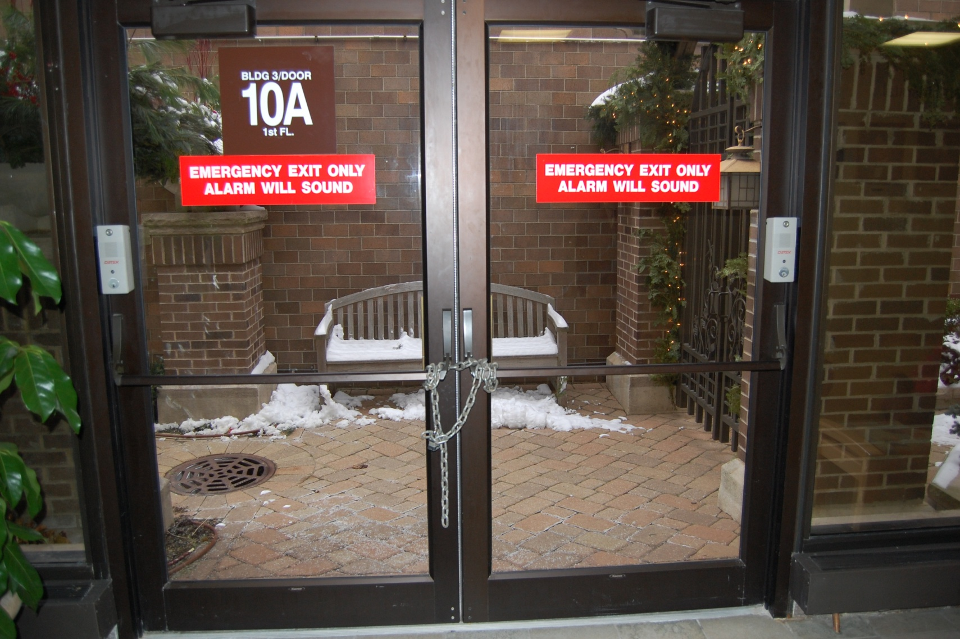
LS.02.01.20 EP 1 Exit Chained Shut

Slide 32
#4 LS.02.01.20 EP 1 & 13 50%
Doors in a means of egress are not equipped with a latch or lock that requires the use of a tool or key from the egress side
Unless permitted by one of the following:
Locking arrangements complying with 19.2.2.2.5
Delayed Egress 18/19.2.2.2.4 & 7.2.1.6.1
Access Controlled 18/19.2.2.2.4 & 7.2.1.6.2
Elevator lobby exit access door 18/19.2.2.2.4 & 7.2.1.6.3
Approved existing door-locking installations
See also 18/19.2.2.2.5.1 & 18/19.2.2.2.5.2
See also 18/19.2.2.2.6 locking related to patient special needs

Slide 33
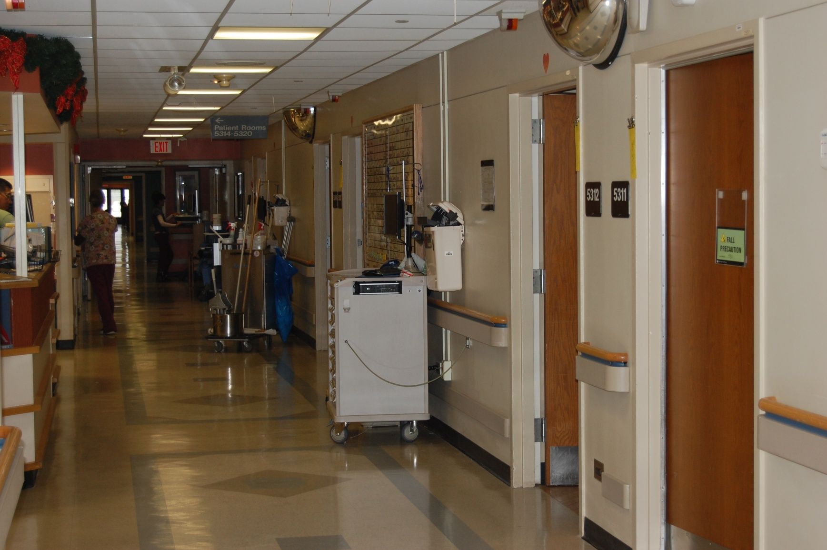
LS.02.01.20 EP 13 Corridor Clutter

Slide 34
LS.02.01.20 EP 13
The hospital maintains the integrity of the means of egress
Anything in the egress corridor more than 30 minutes is storage
Dead end corridors may be used for storage
Less than or equal to 50sqft space
Carts Allowed:
Crash Carts
Isolation Carts
Chemo Carts
Also Allowed:
Fixed Furnishings
Transport Equipment
Wheel Chairs
Lifts

Slide 35
Top 6 Findings In 2016 (continued)
Standard | % Non-compliant | 2016 Rank | EP | Summary
LS.02.01.35 | 47% | 5 | 4 | Manage systems for extinguishing fires including the integrity (nothing supported by sprinkler piping, missing escutcheons)
 |  |  | 14 | Other issues, including: ceiling tiles misplaced (LS.02.01.34 EP 3); K-Type Extinguisher signage (LS.02.01.35 EP 11); blocked access to fire extinguishers
LS.02.01.10 | 46% | 6 | 7 & 8 | Building and fire protection general requirements: Fire-rated door
 |  |  | 9 & 10 | Building and fire protection general requirements: Barrier Penetrations
LS.02.01.30 | 46% | 6 | 2 | Building and fire protection features: Hazardous area doors
 |  |  | 11 | Building and fire protection features: Corridor doors, such as doors to Suites

Slide 36
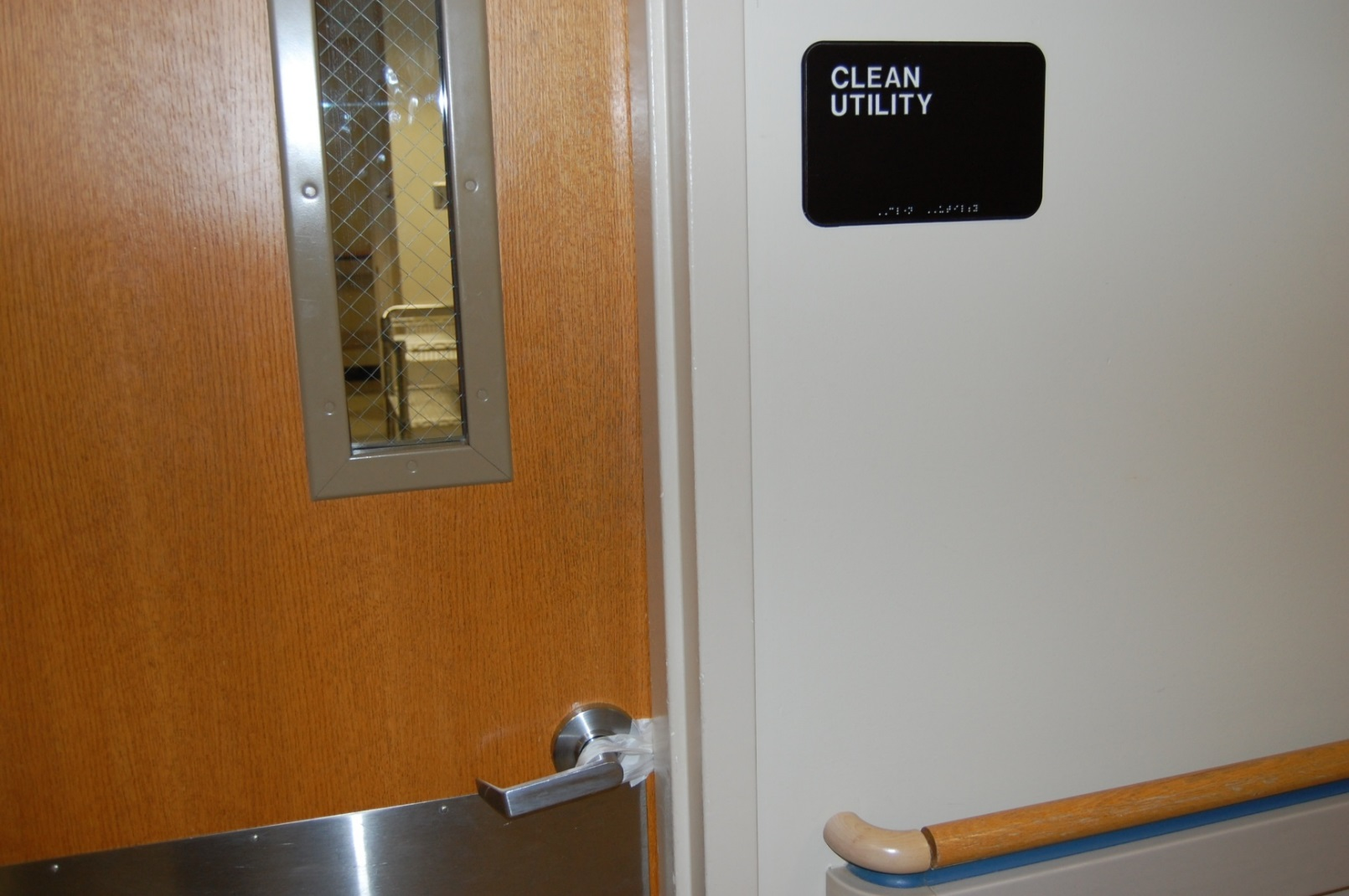

Slide 37
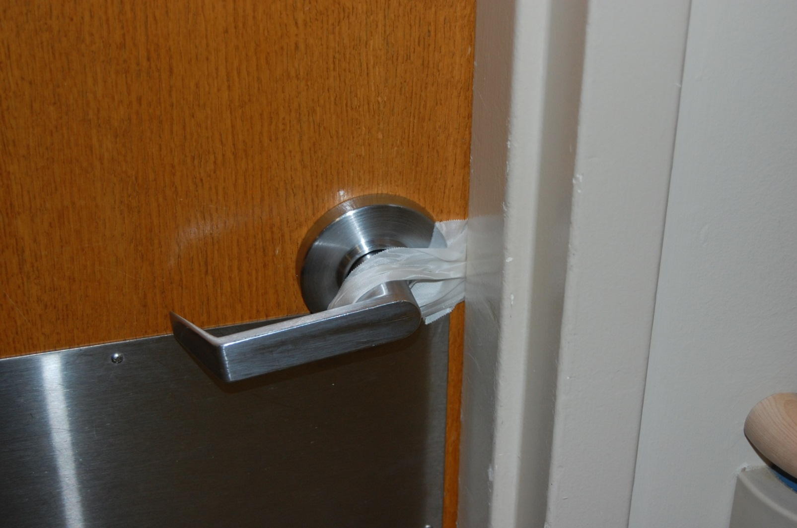

Slide 38
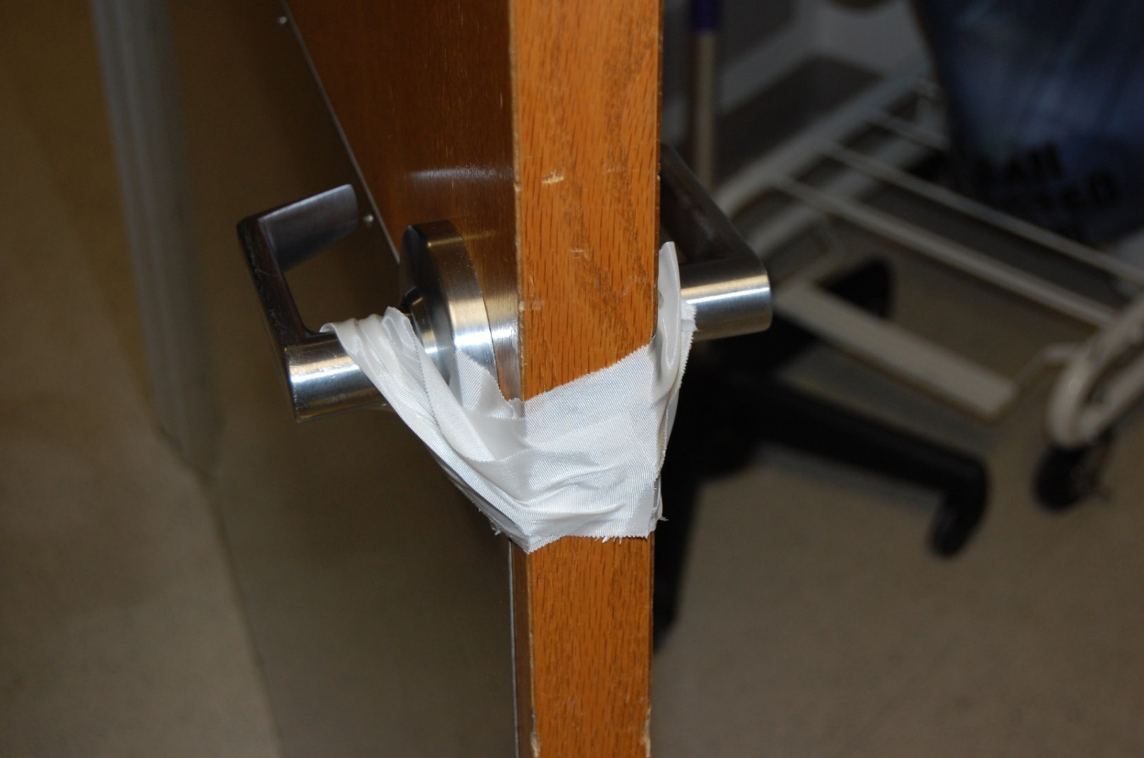

Slide 39
Adoption of the
Life Safety Code (NFPA 101-2012)
and
Health Care Facilities Code (NFPA 99-2012)

Slide 40
CMS Information
Emergency Management
9/2016 Rule published
11/2016 Compliance
11/2017 Implementation
Tuesday May, 3, 2016 CMS issued the final rule adopting the 2012 Life Safety Code®
The rule is effective July 5, 2016
This rule also adopts most of NFPA 99-2012, except:
Ch 7, Information Technology
Ch 8, Plumbing
Ch 12, Emergency Management
Ch 13, Security

Slide 41
CMS Adoption Issues, Including
Roller latches continue to be prohibited
Corridor doors
Doors protecting hazardous areas
ASC that renders one or more incapable continue to be AHC
Outpatient surgical departments
Hospitals may install ABHR provided the installation adequately protects against inappropriate access
Required sprinkler protection of all high rises (>75 ft)
Includes Chapter 43, Building Rehabilitation
Exempts chapters 7, 8, 12 & 13 in NFPA 99-2012

Slide 42
Statement of Conditions™
Plan For Improvement (PFI) Modifications
Interim Life Safety Measures (ILSM)
Extensions
Equivalency Process Modifications

Slide 43
Impact of §488.28(d) Plan For Improvement (PFI)
The PFI Process is now an optional management program made available to the accredited organizations
All PFIs are no longer reviewed as part of survey
All open PFIs are not considered when a Life Safety Chapter deficiency is identified
See it, Cite it survey methodology
The Open PFIs are not imported into the Final Report

Slide 44
CFR Title 42: Public Health… §488.28(d)
Ordinarily a provider or supplier is expected to take the steps needed to achieve compliance within 60-days of being notified of the deficiencies, but the State survey agency may recommend that additional time be granted by the Secretary in individual situations, if in its judgment, it is not reasonable to expect compliance within 60-days, for example, a facility must obtain the approval of its governing body, or engage in competitive bidding

Slide 45
Survey-related Deficiencies: Process
All survey-related deficiencies are cited as RFIs
All survey-related deficiencies are to be corrected within 60-days from the end of survey
For those survey related deficiencies that may take greater than 60 days the organization will need to create a SPFI within 30 days
This initiates the Time Limited Waiver request process
Failure to complete the TLW on time will result in an AFS action

Slide 46
Time-Limited Waiver (TLW)
If additional time is required the organization must submit a Time Limited Waiver
This is managed in Salesforce, and a notification is sent to the organization affirming the TLW request submittal
A second email is sent from the Department of Engineering accepting the application and forwarding it to CMS
This second notification will be used if a MEDDEF or ESC review occurs as Evidence of Compliance (ESC)
A final decision will be emailed and the SOC SPFI will be modified

Slide 47
Time Limited Waiver (TLW)
Organizations that DO NOT use Joint Commission accreditation for deemed status purposes:
Create a Survey-related Plan For Improvement (SPFI)
Enter the requested date in the Scheduled Completion Date field
When prompted, complete the Time Limited Waiver form
Submit to the Joint Commission
The Joint Commission will review the request
Once the decision has been made the Department of Engineering enters the organization SPFI and accepts the new date
After the Department of Engineering modifies the SPFI they will annotate the History Audit Trail

Slide 48
Impact of §488.28(d): Summary
The requested Scheduled Completion Date is a “not to exceed” date
The Open PFI section of the Final Report has been removed
The surveyor will no longer review and accept open PFIs
The PFI component becomes a management program for the organization to use without survey involvement
The surveyor will be provided with a quick-link that will extract only the following:
Statement of Conditions Home Page
Basic Building Information (BBI)
History Audit Trail
Other relevant information

Slide 49
Interim Life Safety Measures
Standards Change
Inclusion in the SPFI Process
Inclusion in the Survey Process

Slide 50
Changes to the ILSM Process
ILSM assessment occurs when a new SPFI is created
There is a drop down menu that includes the 14 ILSM in LS.01.02.01 (EP’s 2 – 15)
The selected ILSM appear in the SPFI
EC deficiencies may require ILSM (as needed)
Survey process:
When a deficiency is discovered the surveyor will discuss which ILSM the organization will implement
The identified ILSM are included in the Requirement for Improvement (RFI)

Slide 51
Creating a New SPFI With ILSM Assessment

Slide 52
Extensions

Slide 53
Extensions
Extensions are no longer granted

Slide 54
Equivalencies:
Only Survey-related Equivalencies Will Be Processed

Slide 55
CMS & Equivalencies
Organizations that use Joint Commission accreditation for deemed status purposes: Survey-related equivalencies will continue to be submitted to our offices
The Engineering staff will work with the organizations until the request is acceptable
Once the equivalency is considered acceptable the Joint Commission will forward the entire request to the CMS Regional Office (RO) for final decision
The CMS RO will send a response to both the organization and Joint Commission
If approved the History Audit Trail will be updated
If denied, the organization will need to either correct the deficiency or re-submit a corrected equivalency

Slide 56
CMS & Equivalencies
Organizations that DO NOT use Joint Commission accreditation for deemed status purposes: Survey-related equivalencies will continue to be submitted to our offices
The Engineering staff will work with the organizations until the request is acceptable
Once the equivalency is considered acceptable the Joint Commission will respond to the organization in the History Audit Trail

Slide 57
2017 Adoption of the
Life Safety Code (NFPA 101-2012)
Health Care Facilities (NFPA 99-2012)

Slide 58
Timeline for Creation of 2012 Standards – Part 1
May 11
July 1
August 21
October 11
December 1
Start Wed 5/4/16
2012 LS & EC Chapter ReWrite-Phase 1 Wed 5/4/16 - Mon 1/9/17
Finish Mon 1/9/17
Rewrite of LS & EC chapters Wed 5/4/16 - Fri 7/1/16
CMS Review Mon 7/4/16 - Fri 9/16/16
TJC Reply Mon 9/19/16 - Tue 10/18/16
Publication Process Mon 9/26/16 - Mon 1/9/17
CMS Final Rule Wed 5/4/16
Database "Lock" for Pubs Sat 9/24/16
Pre-Pubs uploaded Wed 10/26/16

Slide 59
Revisions [Estimated]
Revised Life Safety Chapter
Approximately 22 new Elements of Performance
Approximately 32 modifications
Approximately 5 deletions
Revised Environment of Care Chapter
Approximately 13 new Elements of Performance
Approximately 31 modifications
Approximately 1 deletion

Slide 60
2017 Highlights of the Environment of Care Chapter

Slide 61
EC.02.02.01
EP 9 modified to include
Waste Anesthetic Gas Disposal (WAGD)
Lab rooftop discharge signage

Slide 62
EC.02.03.01 EP 9
The written fire response plan describes the specific roles of staff and licensed independent practitioners at and away from a fire's point of origin, including when and how to sound and report fire alarms, how to contain smoke and fire, how to use a fire extinguisher, how to assist and relocate patients, and how to evacuate to areas of refuge.
Note: For additional guidance, see NFPA 101-2012: 18/19: 7.1; 7.2.

Slide 63
EC.02.03.03 EP 3
When quarterly fire drills are required, at least 50% THEY are unannounced. Fire drills are held at unexpected times and under varying conditions. Fire drills include transmission of fire alarm signal and simulation of emergency fire conditions.
Note 1: When drills are conducted between 9:00 P.M. and 6:00 A.M., the hospital may use alternative methods to notify staff instead of activating audible alarms.
Note 2: For additional guidance, see NFPA 101-2012: 18/19: 7.1.7; 7.1; 7.2; 7.3.

Slide 64
EC.02.03.05
Defined supervisory signals at EP 1
Control valves; pressure supervisory; pressure tank, pressure supervisory for dry pipe, steam pressure; water level supervisory signal initiating device, water temperature supervisory and room temperature supervisory
Clarified electromechanical devices as door-releasing devices
Allow monthly test under no-flow conditions for electric motor driven fire pumps

Slide 65
EC.02.03.05 (continued)
Fire extinguisher
Clear and unobstructed access
Charge level and intact
Individuals performing annual maintenance on extinguishers are certified
Door maintenance annually
Includes pre-test visual inspection
Documentation activities
Inventory of devices, equipment and other items
Includes fire alarm and fire protection systems

Slide 66
EC.02.03.05 (continued)
EP 25 The hospital has written documentation of annual inspection and testing of door assemblies by individuals who can demonstrate knowledge and understanding of the operating components of the door being tested. Testing begins with a pre-test visual inspection; testing includes both sides of the opening.
Note: For additional guidance on testing of door assemblies, see NFPA 101-2012: 7.2.1.5.10.1; 7.2.1.5.11; NFPA 80-2010: 4.8.4; 5.2.1; 5.2.3; 5.2.4; 5.2.6; 5.2.7; 6.3.1.7; NFPA 105-2010: 5.2.1.

Slide 67
EC.02.03.05 (continued)
EP 27 Documentation of maintenance, testing, and inspection activities for Standard EC.02.03.05, EPs 1–20, 25 (including fire alarm and fire protection systems) includes the following:
Name of the activity
Date of the activity
Inventory of devices, equipment, or other items
Required frequency of the activity - Name and contact information, including affiliation, of the person who performed the activity
NFPA standard(s) referenced for the activity
Results of the activity
Note: For additional guidance on documenting activities, see NFPA 25-2011: 4.3; 4.4; NFPA 72-2010: 14.2.1; 14.2.2; 14.2.3; 14.2.4.

Slide 68
EC.02.04.03 EP 14
The hospital meets all other HealthCare Facilities Code requirements; facilities code for electrical equipment in the patient care vicinity as related to NFPA 99-2012: Chapter 10.
Note: For hospitals that use Joint Commission accreditation for deemed status purposes: the hospital meets the applicable provisions of the Life Safety Code Tentative Interim Amendment (TIA) 12-5.

Slide 69
EC.02.05.01
Labeling utility system controls to facilitate shutdown, such as
Utility source valves
Utility system main switches and valves
Individual circuits in electrical distribution panel
Fire Alarm Circuit is clearly labeled as such and is marked in red
Disconnect method (i.e. circuit breaker)
Restricted access
Information where the dedicated branch is located in the control unit

Slide 70
EC.02.05.01 (continued)
Non-critical area ventilation systems
Temperature, Humidity and Pressure Relationships
Medical gas storage rooms, transfer and manifold room criteria
Emergency Power Supply System (EPSS) equipment and environment are maintained
Ambient Temperature at least 40°F
Ventilation
Supply
Exhaust
Water-jacket Temperature

Slide 71
EC.02.05.03
Type 1 or Type 3 essential electrical systems comply with NFPA 99-2012 if upgraded since 1983
Essential electrical system must be divided into three branches
Life safety branch
Critical branch
Equipment branch

Slide 72
EC.02.05.03 (CONTINUED)
Emergency power provided within 10 seconds
Generator locations
Emergency lighting
Remote manual stop with appropriate signage
Remote annunciator

Slide 73
EC.02.05.05
When performing repairs or maintenance there is a process to manage risks associated with air-quality requirements, infection control, utility requirements, noise, odor, dust, vibration, and other hazards
High risk PM completion rate: 100%
Infection Control equipment completion rate: 100%
Non-high risk completion rate:
100% of the scheduled activities
Defined by organization for frequency

Slide 74
EC.02.05.07
Weekly inspection of the Emergency Power Supply System, including components and batteries
During the monthly generator test the cool-down period is not part of the 30 minute run-time
Reduced the annual load bank to 90 minutes
30 minutes at 50% of nameplate
60 minutes at 75% of nameplate
NOTE: the first 30 minutes can accommodate the monthly generator test

Slide 75
EC.02.05.09 EP 2
When the hospital has bulk oxygen systems above ground:
They are in a locked enclosure (such as a fence) at least 10 feet measured from the side of the tank to vehicles and sidewalks
There is permanent signage stating “OXYGEN – NO SMOKING – NO OPEN FLAMES.”
Note: For additional guidance, refer to NFPA 99-2012: 5.1.3.5.12.

Slide 76
EC.02.05.09
Implement a policy on all cylinders that includes the following:
Proper handling and transporting (for example, in carts, attached to equipment, on racks) to ensure safety
Physically segregating full and empty cylinders from each other in order to assist staff in selecting the proper cylinder
Labeling empty cylinders
Prohibiting transfilling in any compartment with patient care
Notes:
76

Slide 77
EC.02.05.09 (continued)
Emergency Oxygen Supply Connections (EOSC)
Clarifies inspection and testing:
The source, distribution, inlets/outlets, and alarms that protect the piped medical gas systems
Bulk Oxygen systems (above ground)
Locked enclosure
At least 10 feet, measured from the side of the tank to vehicles and sidewalks
Signage:
OXYGEN – NO SMOKING – NO OPEN FLAMES

Slide 78
Life Safety Chapter 2017

Slide 79
LS.01.01.01 & LS.01.02.01
LS.01.01.01
Individuals assigned to assess compliance with the LSC and when manage the SOC and survey related deficiencies
Building assessment for LS Chapter compliance
Current and accurate drawings
Survey-related deficiencies completed within 60-days or Time Limited Waiver
Existing life safety features obvious to the public must be either maintained or removed (4.6.12.2)

Slide 80
LS.01.02.01
Evacuate or fire watch
4 out of 24 hours for fire alarm compromised
10 out of 24 for sprinkler system compromised
Re-ordered ILSM EPs
New EP 15: If the hospital's policy allows the use of other ILSMs not addressed in EPs 2–14, the other ILSMs used are documented in the "other" section of the hospital's Survey-Related Plan for Improvement (SPFI) within the Statement of Conditions™ (SOC).

Slide 81
LS.02.01.10
Added Chapter 43 reference
Building Rehabilitation
Fire protection ratings for openings
From 20 minutes to 3 hours
Added that blocking or wedging fire rated doors is prohibited
Removed unapproved protective plates requirement

Slide 82
LS.02.01.20
Added compliant locking based on security
Access and delayed-egress
Clarified exit enclosure is not to be used for anything that does not support the enclosure
Added two notes about
Wheeled Equipment
Fixed furnishings
Added Suites separation and subdivision
Added clarification on second exit from suites
Allowed the larger sleeping suite sizes

Slide 83
LS.02.01.30
Re-designed hazardous areas EPs
Limited cooking allowed
Specific EP about Alcohol-Based Hand Rub (ABHR)
Clarified New and Existing corridor separations
Sleeping rooms have windows
Window sill height in new construction at 36”

Slide 84
LS.02.01.34
Ceiling membrane is to be intact

Slide 85
LS.02.01.35
Clarified escutcheon plates must be installed
Six spare sprinkler heads
Closet does not require sprinkler protection
Size limitation
Fire extinguisher mounting
K-Type fire extinguisher placard requirement

Slide 86
LS.02.01.70
“NO SMOKING” signage
Secondary signage exception does not apply to medical gas storage areas
Smoking permitted areas have non-combustible ashtrays and metal containers with self-closing lids in which ashtrays can be emptied
96 Gallons (or less) are labeled and listed
Permitted in unprotected area
Used only for recycle clean waste

Slide 87
2018 Draft
Environment of Care Life Safety Chapter
PROPOSED
George Mills, Director Department of Engineering

Slide 88
Adoption of the
Life Safety Code (NFPA 101-2012)
Health Care Facilities (NFPA 99-2012)

Slide 89
Timeline for Creation of 2012 Standards, K-Tag Creation
November
January
March
May
July
September
November
January
Start Fri 9/2/16
LS/EC ESTIMATED Schedule Fri 9/2/16 - Tue 1/2/18 – 487 days
Finish Tue 1/2/18
K-Tag EP Production, CMS Responses, ILSM Fri 9/2/16 - Wed 1/18/17 – 138 days
CMS Review Process Thu 1/19/17 - Fri 6/23/17 – 155 days
Field notification, non-deemed programs Fri 6/30/17 - Thu 12/28/17 – 181 days (6 months)
Publication Schedule Mon 7/24/17 - Tue 1/2/18 – 162 days
Content Cut Off Mon 7/24/17

Slide 90
Elements of Performance
PROPOSED
The following EP are in development and may be modified prior to final release
These EP are based on compliance with the Life Safety Code® (NFPA 101-2012) and the Health Care Facilities Code (NFPA 99-2012)
CMS issued K Tags late in 2016, causing TJC to miss the 1/2017 release
These are preliminary and not ready for publication
Slides will have “Proposed” on them
These are being reviewed and processed in 2017
The anticipated release date is 1/2018
Those discussed today are to be guiding EP and cited as recommended
Notes:
90

Slide 91
Environment of Care Chapter
PROPOSED
2018
Notes:
91

Slide 92
Elements of Performance
PROPOSED
For modified Elements of Performance the slide title has the current number, but the content includes the proposed new number as “Suggested placement:”
Patient care areas are scored at EC.02.06.01 EP 1 unless a more appropriate location is identified
Non-patient care issues are scored at LD.04.01.01 EP 2 as a requirement to comply with laws and regulations, unless a more appropriate location is identified
Compliance with NFPA is required in the adoption of the Life Safety Code

Slide 93
Elements of Performance
PROPOSED
2017 created a series of “meets all other HFC requirements for … ” and will be used when possible
EC.02.04.03 EP 14 (refers to 99-2012 chapter 10)
EC.02.05.01 EP 18 (refers to 99-2012 9.3.7, gas storage)
EC.02.05.05 EP 7 (refers to 99-2012 chapters 6 & 9)
EC.02.05.09 EP 7 (refers to 99-2012 chapters 5 & 11)

Slide 94
EC.02.05.05 EP 7
PROPOSED
The hospital meets all other HealthCare Facilities Code requirements for electrical distribution, HVAC, as related to NFPA 99-2012: Chapters 6 and 9.
Note: For hospitals that use Joint Commission accreditation for deemed status purposes: the hospital meets the applicable provisions of the Life Safety Code Tentative Interim Amendments (TIAs) 12-2 and 12-3.

Slide 95
EC.02.04.03 EP 14 (K921, K924)
PROPOSED
The organization has a library of
service manuals
instructions manuals
procedures provided by manufacturer’s, maintenance manuals
technical bulletins
specification information and other information for the inspection, testing and maintenance of equipment and systems
See NFPA 99-2012 10.5.3 and 10.5.6
Suggested placement: EC.01.01.01 EP 3
NEW

Slide 96
EC.02.03.01 EP 9 (K711)
PROPOSED
The written fire response plan describes ….
how to assist and relocate patients, and how to evacuate to areas of refuge. [2017]
Employees are periodically instructed and kept informed with their duties under the plan.
A copy of the plan is readily available with the telephone operator or security. [2018] Note: For additional guidance, see NFPA 101, 2012 edition, 18/19: 7.1; 7.2.
Modified

Slide 97
LD.04.01.01 EP 2 (K932)
PROPOSED
The organization meets all other Health Care Facilities Code fire protection requirements, as related to NFPA 99-2012: Chapter 15.
Suggested placement: EC.02.03.01 EP 11
NEW

Slide 98
EC.02.06.01 EP 1 (K933)
PROPOSED
Periodic evaluations are made related to fire loss prevention in operating rooms, including hazards that could be encountered during surgical procedures, and fire prevention procedures are established.
Procedures are established for operating room emergencies including alarm activation, evacuation, equipment shutdown, and control operations.
Emergency procedures include the control of chemical spills, and extinguishment of drapery, clothing and equipment fires.
Suggested placement: EC.02.03.03 EP 4
NEW
Notes:
98

Slide 99
EC.02.06.01 EP 1 (K933) (cont.)
PROPOSED
Continued …
Training is provided to new OR personnel (including surgeons), continuing education is provided, incidents are reviewed monthly, and procedures are reviewed annually.
When flammable germicides or antiseptics are employed during surgeries utilizing electrosurgery, cautery or lasers:
packaging is non-flammable
applicators are in unit doses
….
NEW
Notes:
99

Slide 100
EC.02.06.01 EP 1 (K933) (cont.)
PROPOSED
Preoperative "time-out" is conducted prior the initiation of any surgical procedure to verify:
application site is dry prior to draping and use of surgical equipment
pooling of solution has not occurred or has been corrected
solution-soaked materials have been removed from the OR prior to draping and use of surgical devices
policies and procedures are established outlining safety precautions related to the use of flammable germicide or antiseptic use.
(For full text refer to NFPA 99-2012: 15.13)
NEW
Notes:
100

Slide 101
EC.02.03.05 EP 26 (K531)
PROPOSED
Elevator Firefighter’s Service is operated monthly with a written record. NFPA 101-2012: 9.4.2.
NEW

Slide 102
LD.04.01.01 EP 2 (K931) (K919)
PROPOSED
All occupancies containing hyperbaric facilities comply with construction, equipment, administration, and maintenance requirements of NFPA 99-2012, Chapter 14.
Suggested placement: EC.02.04.03 EP 8
NEW
Notes:
102

Slide 103
EC.02.05.01 EP 1 (K321, K341, K352, K521, K908)
PROPOSED
EP 1 The hospital designs and installs utility systems that meet patient care and operational needs.
NOTE: All utility systems, such as the fire alarm system, HVAC system, medical gases and vacuum, and automatic sprinkler systems are designed and installed according to NFPA Codes.
Modified
Notes:
103

Slide 104
LD.04.01.01 EP 2 (K901)
PROPOSED
Building systems are designed to meet Categories 1 – 4 requirements.
These are established by formal and documented risk assessment procedure by qualified personnel.
See NFPA 99-2012 Chapter 4 for description of the four categories related to gas, vacuum, electrical and electrical equipment.
Suggested placement: EC.02.05.01 EP 2
NEW
Notes:
104

Slide 105
EC.02.05.09 EP 7 (K323)
PROPOSED
Areas designated for administration of general anesthesia (i.e., inhalation anesthetics) using medical gases or vacuum are in accordance with 8.7 and NFPA 99.
Zone valves are located immediately outside each anesthetizing location for medical gas or vacuum; readily accessible in an emergency; and arranged so shutting off any one anesthetizing location will not affect others.
Area alarm panels are provided to monitor all medical gas, medical-surgical vacuum, and piped WAGD systems.
Suggested placement: EC.02.05.01 EP 20
NEW

Slide 106
EC.02.05.09 EP 7 (cont.)
PROPOSED
Continued…
Panels are at locations that provide for surveillance, indicate medical gas pressure decreases of 20% and vacuum decreases of 12-inch gauge HgV, and provide visual and audible indication.
Alarm sensors are installed either on the source side of individual room zone valve box assemblies or on the patient/use side of each of the individual zone box valve assemblies.
For full text refer to NFPA 101-2012: 18/19.3.2.3; NFPA 99-2012: 5.1.4.8.7, 5.1.4.8.7.2, 5.1.9.3, 5.1.9.3.4, 6.4.2.2.4.2
NEW

Slide 107
EC.02.05.05 EP 7 (K323)
PROPOSED
Areas designated for administration of general anesthesia (i.e., inhalation anesthetics) has the EES critical branch supplying power in accordance with 8.7 and NFPA 99.
The EES critical branch supplies power for task illumination, fixed equipment, select receptacles, and select power circuits, and EES equipment system supplies power to ventilation system.
For full text refer to NFPA 101-2012: 18/19.3.2.3; NFPA 99-2012: 6.4.2.2.4.2
Suggested placement: EC.02.05.01 EP 21
NEW

Slide 108
EC.02.05.05 EP 7 (K323)
PROPOSED
Areas designated for administration of general anesthesia (i.e., inhalation anesthetics) has the heating, cooling and ventilation systems in accordance with 8.7 and NFPA 99.
Heating, cooling, and ventilation are in accordance with ASHRAE 170. Medical supply and equipment manufacturer’s instructions for use are considered before reducing humidity levels to those allowed by ASHRAE.
Suggested placement: EC.02.05.01 EP 22
NEW

Slide 109
EC.02.05.05 EP 7 (K323) (cont.)
PROPOSED
Continued…
Supply and exhaust systems for windowless anesthetizing locations have smoke control system(s) to automatically vent smoke, prevent the recirculation of smoke originating within the surgical suite, and prevent the circulation of smoke entering the system intake, without interfering with exhaust function.
For full text refer to NFPA 101-2012: 18/19.3.2.3; NFPA 99-2012: 9.3.1, 9.3.3, 9.3.7, 9.3.8, 9.3.9.
NEW

Slide 110
EC.02.05.05 EP 7(K913)
PROPOSED
Operating rooms are considered wet procedure locations, unless otherwise determined by a risk assessment conducted by the facility governing body.
Operating rooms defined as wet locations are protected by either isolated power or ground-fault circuit interrupters.
A written record of the risk assessment is maintained and available for inspection. (For full text refer to NFPA 99-2012: 6.3.2.2.8.4, 6.3.2.2.8.7, 6.4.4.2)
Suggested placement: EC.02.05.01 EP 23
NEW
NEW
Notes:
110

Slide 111
EC.02.05.05 EP 7 (K914, K917)
PROPOSED
Hospital-grade receptacles at patient bed locations and where deep sedation or general anesthesia is administered
are tested after initial installation, replacement or servicing
In pediatric locations, receptacles in patient rooms, bathrooms, play rooms, and activity rooms (other than nurseries), are listed tamper-resistant or employ a listed cover
Electrical receptacles or cover plates supplied from the life safety and critical branches have a distinctive color or marking
(For full text refer to NFPA 99-2012: 6.3.2; 6.3.3; 6.3.4; 6.4.2.2.6; 6.5.2.2.4.2; 6.6.2.2.3.2)
Suggested placement: EC.02.05.01 EP 25
NEW
Notes:
111

Slide 112
EC.02.04.03 EP 14
PROPOSED
All power strips are used with general precautions.
Extension cords are not used as a substitute for fixed wiring of a structure.
Extension cords used temporarily are removed immediately upon completion of the purpose for which it was installed and meets the conditions of 10.2.4.
(For full text refer to NFPA 99-2012: 10.2.3.6; 10.2.4; NFPA 70-2011: 400-8; 590.3(D), Tentative Interim Amendment (TIA) 12-5)
Suggested placement: EC.02.05.01 EP 26
NEW
Notes:
112

Slide 113
EC.02.05.03 EP 3 (K292)
PROPOSED
The hospital provides emergency power within 10 seconds for new buildings equipped with or requiring the use of life support systems (electro-mechanical or inhalation anesthetics) have illumination of
means of egress
emergency lighting equipment
exit
emergency lighting at emergency generator locations
directional signs supplied by the life safety branch of the electrical system described in NFPA 99.
(For full text refer to NFPA 101-2012: 18.2.9.2, 18.2.10.5; and NFPA 99-2012: 6.4.2.2.3)
Note: 6.4.2.2.3; and NFPA 110-2010, 4.1; Table 4.1(b)
Modified
Notes:
113

Slide 114
EC.02.05.05 EP 7 (K914, K912)
PROPOSED
Hospital-grade receptacles at patient bed locations and where deep sedation or general anesthesia is administered, are
Tested after initial installation, replacement or servicing
Additional testing is performed at intervals defined by documented performance data
Receptacles not listed as hospital-grade at these locations are tested at intervals not exceeding 12 months.
Line isolation monitors (LIM), if installed, are tested at intervals of ≤ 1 month by actuating the LIM test switch per 6.3.2.6.3.6, which activates both visual and audible alarm.
Suggested placement: EC.02.05.05 EP 7
NEW
Notes:
114

Slide 115
(cont.)
PROPOSED
Continued …
For LIM circuits with automated self-testing, this manual test is performed at intervals ≤ 12 months.
LIM circuits are tested per 6.3.3.3.2 after any repair or renovation to the electric distribution system.
Records are maintained of required tests and associated repairs or modifications, containing date, room or area tested, and results.
(For full text refer to NFPA 99-2012: 6.3.2; 6.3.3; 6.3.4)
NEW
Notes:
115

Slide 116
EC.02.05.07 EP 5
PROPOSED
At least monthly, the hospital tests each emergency generator beginning with a cold start under load for at least 30 continuous minutes.
The cool down period is not part of the 30 continuous minutes.
The test results and completion dates are documented.
For further information, refer to NFPA 99-2012: 6.4.4.1
Modified

Slide 117
EC.02.05.09 EP 7 (K903)
PROPOSED
Medical gas, medical air, surgical vacuum, WAGD, and air supply systems in which failure is likely to cause major injury or death are designated:
Category 1: Systems in which failure is likely to cause minor injury to patients are designated
Category 2: Systems in which failure is not likely to cause injury, but can cause discomfort is designated
Category 3: Deep sedation and general anesthesia are not administered when using Category 3 medical gas system
(For full text refer to NFPA 99-2012: 5.1.1.1; 5.2.1; 5.3.1.1; 5.3.1.5)
Suggested placement: EC.02.05.09 EP 1
NEW
Notes:
117

Slide 118
EC.02.05.09 EP 7 (K907)
PROPOSED
All master, area, and local alarm systems used for medical gas and vacuum systems comply with the appropriate Category warning system requirements. (For full text refer to NFPA 99-2012: 5.1.9, 5.2.9, 5.3.6.2.2)
Suggested placement: EC.02.05.09 EP 2
NEW
Notes:
118

Slide 119
EC.02.05.09 EP 5 (K909)
PROPOSED
The hospital makes main supply valves and area shutoff valves for piped medical gas and vacuum systems accessible and clearly identifies what the valves control.
Piping is labeled by stencil or adhesive markers identifying the gas or vacuum system, including the name of system or chemical symbol, color code (see Table 5.1.11), and operating pressure if other than standard.
Modified
Notes:
119

Slide 120
EC.02.05.09 EP 5 (cont.)
PROPOSED
Continued…
Labels are at intervals not more than 20 ft., are in every room, at both sides of wall penetrations, and on every story traversed by riser.
Piping is not painted.
Shutoff valves are identified with
the name or chemical symbol of the gas or vacuum system,
room or area served,
caution to not use the valve except in emergency.
(For full text refer to NFPA 99-2012: 5.1.11.1; 5.1.11.2; 5.1.14.3; 5.2.11; 5.3.13.3; 5.3.11)
Modified
Notes:
120

Slide 121
EC.02.05.09 EP 6 (K906, K928, K929)
PROPOSED
The hospital implements a policy on all cylinders within the hospital that includes the following:
Cylinders are labeled and handled in accordance with NFPA 99-2012 11.5.3.1 and 11.6.2
Proper handling and transporting (for example, in carts, attached to equipment, on racks) to ensure safety Physically segregating full and empty cylinders from each other in order to assist staff in selecting the proper cylinder
Adaptors or conversion fittings are prohibited
Oxygen cylinders, containers, and associated equipment are protected from contact with oil and grease, from contamination, protected from damage, and handled with care
Modified
Notes:
121

Slide 122
EC.02.05.09 EP 6 (cont.)
PROPOSED
Cylinders are kept away from heat and flammable materials, and are prevented from exceeding 130°F
Nitrous oxide and carbon dioxide cylinders are prevented from reaching temperatures lower than manufacture recommendations or 20°F
Valve protection caps are secured in place if supplied and cylinder is not in use
Labeling empty cylinders
Note: (For full text refer to NFPA 99-2012: 5.1.3.2; 5.1.3.3; 5.2.3.2; 5.2.3.3; 5.3.6.20; 11.6.2; 11.6.2.3; 11.6.5; 11.6.5.2; 11.6.5.3; 11.7.3.2).
Modified
Notes:
122

Slide 123
EC.02.06.05 EP 3
PROPOSED
The [ORGANIZATION] takes action based on its assessment to minimize risks during demolition, construction, renovation or general maintenance.
Modified

Slide 124
EC.02.06.01 EP 1
PROPOSED
Personnel responsible for the maintenance, inspection and testing and use of medical equipment, utility systems and equipment, fire safety systems and equipment, and the safe handling of hazardous materials and waste are competent and receive continuing education and training.
(K50, K712, K718, K901, K907, K920, K921, K926, K933)
Suggested placement: EC.03.01.01 EP 1
NEW
Notes:
124

Slide 125
Life Safety Chapter
PROPOSED
2018
Notes:
125

Slide 126
Proposed Elements of Performance
The following EP are in development and may be modified prior to final release
These EP are based on compliance with the Life Safety Code® (NFPA 101-2012) and the Health Care Facilities Code (NFPA 99-2012)
CMS issued K Tags late in 2016, causing TJC to miss the 1/2017 release
These are preliminary and not ready for publication
Slides will have “Proposed” on them
These are being reviewed and processed in 2017
The anticipated release date is 1/2018
Those discussed today are to be guiding EP and cited as recommended
Notes:
126

Slide 127
Proposed Elements of Performance
For new Elements of Performance in the LS chapter score to the applicable EP that requires compliance with the entire codes section, such as
LS.02.01.20 EP 36
The hospital meets all other Life Safety Code means of egress requirements related to NFPA 101-2012: 18/19.2

Slide 128
All other requirements…
General Requirements: Life Safety deficiencies that are not currently identified as an Elements of Performance are scored here:
LS.02.01.10 EP 11 The hospital meets all other Life Safety Code requirements related to NFPA 101-2012: 18/19.1.
Means of Egress: Life Safety deficiencies that are not currently identified as an Elements of Performance are scored here:
LS.02.01.20 EP 36 The hospital meets all other Life Safety Code means of egress requirements related to NFPA 101-2012: 18/19.2.

Slide 129
All other requirements…
Protection: Life Safety deficiencies that are not currently identified as an Elements of Performance are scored here:
LS.02.01.30 EP 25 The hospital meets all other Life Safety Code fire and smoke protection requirements related to NFPA 101-2012: 18/19.3.
Notification: Life Safety deficiencies that are not currently identified as an Elements of Performance are scored here:
LS.02.01.34 EP 4 The hospital meets all other Life Safety Code fire alarm requirements related to NFPA 101-2012: 18/19.3.4.

Slide 130
All other requirements…
Suppression: Life Safety deficiencies that are not currently identified as an Elements of Performance are scored here:
LS.02.01.35 EP 14 The hospital meets all other Life Safety Code automatic extinguishing requirements related to NFPA 101-2012: 18/19.3.5.
Building Services: Life Safety deficiencies that are not currently identified as an Elements of Performance are scored here:
LS.02.01.50 EP 8 The hospital meets all other Life Safety Code building service requirements related to NFPA 101-2012: 18/19.5.4.
Operating Features: Life Safety deficiencies that are not currently identified as an Elements of Performance are scored here:
LS.02.01.70 EP 6 The hospital meets all other Life Safety Code operating feature requirements related to NFPA 101-2012: 18.7/19.7.

Slide 131
Life Safety deficiencies that are not currently identified as an Elements of Performance are scored here:
LS.02.01.10 EP 11 The hospital meets all other Life Safety Code requirements related to NFPA 101-2012: 18/19.1.

Slide 132
LS.02.01.10 EP 2 (K111)
PROPOSED
EP 2 When building rehabilitation occurs, the hospital incorporates both NFPA 101-2012: chapters 18, 19 and 43 (Building Rehabilitation). (For full text, refer to NFPA 101-2012: Chapter 43; 18/19.1.1.4.3; 18.4.3.1 – 18.4.3.5 and 19.4.3)
Modified
Notes:
132

Slide 133
LS.02.01.10 EP 11 (K111)
PROPOSED
Any building undergoing change of use or change of occupancy classification complies with Chapter 43.7, unless permitted by 18/19.1.1.4.2.
Suggested placement: LS.02.01.10 EP 3
When an addition is made to a building the building is in compliance with Chapter 18 and Chapter 43.8 of the NFPA 101-2012 Life Safety Code.
Suggested placement: LS.02.01.10 EP 4
NEW
NEW
Notes:
133

Slide 134
LS.02.01.10 EP 11
PROPOSED
EP 15 The hospital meets all other Life Safety Code requirements related to NFPA 101-2012: 18/19.1.
Modified
Notes:
134

Slide 135
Life Safety deficiencies that are not currently identified as an Elements of Performance are scored here:
LS.02.01.20 EP 36
The hospital meets all other Life Safety Code means of egress requirements related to NFPA 101-2012: 18/19.2.

Slide 136
LS.02.01.20 EP 36 (K211)
PROPOSED
The capacity of the means of egress shall be in accordance with 7.3. (For full text refer to NFPA 101-2012: 18/19.2.3.1)
Suggested placement: LS.02.01.20 EP 11
NEW
Notes:
136

Slide 137
LS.02.01.20 EP 9 (K211)
PROPOSED
EP 12 Exits discharge to the outside at grade level or through an approved exit passageway that is continuous and provides a level walking surface. The exit discharge shall be a hard packed all weather travel surface, free from obstructions and terminates at a public way or at an exterior exit discharge. (For full text, refer to NFPA 101-2012: 18/19.2.7; 7.1.7; 7.1.10.1; 7.2.6 and 7.7.2)
Modified
Notes:
137

Slide 138
LS.02.01.20 EP 13 (K241)
PROPOSED
EP 16 Not less than two exits, remote from each other, and accessible from every part of every story are provided for each story.
Each smoke compartment shall also be provided with two distinct egress paths to exits that do not require the entry into the same adjacent smoke compartment.
(For full text refer to NFPA 101-2012: 18/19.2.4.1-18/19.2.4.4)
Modified
Notes:
138

Slide 139
LS.02.01.20 EP 36 (K252)
PROPOSED
Every corridor shall provide access to not less than two approved exits in accordance with Sections 7.4 and 7.5 without passing through any intervening rooms or spaces other than corridors or lobbies. (For full text refer to NFPA 101-2012: 18/19.2.5.4)
Suggested placement: LS.02.01.20 EP 17
NEW
Notes:
139

Slide 140
LS.02.01.20 EP 33 (K291)
PROPOSED
EP 39 Illumination in the means of egress, including exit discharges, is arranged so that failure of any single light fixture or bulb will not leave the area in darkness (< 0.2 foot candles).
Emergency lighting of at least 1½-hour duration is provided automatically in accordance with 7.9.
(For full text, refer to 101-2012: 18/19.2.8; 18/19.2.9.1; 7.8.1.4; 7.9.2)
Modified

Slide 141
LS.02.01.20 EP 34 (K293)
PROPOSED
EP 40 Exit signs are visible when the path to the exit is not readily apparent.
Signs are adequately lit and have letters that are four or more inches high (or six inches high if externally lit).
Exit and directional signs are displayed with continuous illumination also served by the emergency lighting system unless the building is one story with less than 30 occupants, and the line of exit travel is obvious.
(For full text, refer to NFPA 101-2012: 18/19.2.10; 18/19.2.10.1; 18/19.2.10.5; 7.10.1.4; 7.10.1.5.1; 7.10.5; 7.10.6; 7.10.7)
Modified
Notes:
141

Slide 142
LS.02.01.20 EP 36 (K200)
PROPOSED
EP 42 The hospital meets all other Life Safety Code means of egress requirements related to NFPA 101-2012: 18/19.2
Re-numbering

Slide 143
Life Safety deficiencies that are not currently identified as an Elements of Performance are scored here:
LS.02.01.30 EP 25
The hospital meets all other Life Safety Code fire and smoke protection requirements related to NFPA 101-2012: 18/19.3.

Slide 144
LS.02.01.30 EP 25 (K322)
PROPOSED
Laboratories employing quantities of flammable, combustible, or hazardous materials that are considered as a severe hazard shall be in accordance with Section 8.7 and the provisions of NFPA 99, Health Care Facilities Code, applicable to administration, maintenance, and testing. (For full text refer to NFPA 101-2012: 18/19.3.2.2)
Suggested placement: LS.02.01.30 EP 4
NEW
Notes:
144

Slide 145
LS.02.01.30 EP 5 (K325)
PROPOSED
EP 6 Alcohol-Based Hand Rubs (ABHR) are protected in accordance with 8.7.3.1, unless all conditions are met:
Corridor is at least 6 feet wide
Maximum individual dispenser capacity is 0.32 gal. (0.53 gal. in suites) of fluid and 18 oz. of Level 1 aerosols
Dispensers shall have a minimum of 4-foot horizontal spacing
Not more than an aggregate of 10 gallons of fluid or 135 oz. aerosol are used in a single smoke compartment outside a storage cabinet, excluding one individual dispenser per room
Modified
Notes:
145

Slide 146
LS.02.01.30 EP 5 (cont.)
PROPOSED
Storage in a single smoke compartment greater than 5 gallons complies with NFPA 30
Dispensers are not installed within 1 inch of an ignition source
If floor is carpeted, the building is fully sprinkler protected
ABHR does not exceed 95% alcohol •
Operation of the dispenser shall comply with Section 18.3.2.6(11) or 19.3.2.6(11)
ABHR is protected against inappropriate access
(For full text refer to NFPA 101-2012: 18/19.3.2.6; 8.7.3.1; CFR 416.44)
Modified
Notes:
146

Slide 147
LS.02.01.34 EP 4 (K341)
PROPOSED
A fire alarm system is installed with systems and components in accordance with NFPA 70, National Electric Code, and NFPA 72, National Fire Alarm Code to provide effective warning of fire in any part of the building.
Suggested placement: LS.02.01.34 EP 1
NEW
Notes:
147

Slide 148
LS.02.01.34 EP 4 (K341)
PROPOSED
The master fire alarm control panel is located in an area with a smoke detector or is in an area that is a continuously occupied and protected environment, which is an area enclosed with one-hour–fire-rated walls and 3/4-hour–fire-rated doors.
In areas not continuously occupied, detection is installed at each fire alarm control unit.
In new occupancy, detection is also installed at notification appliance circuit power extenders, and supervising station transmitting equipment.
Fire alarm system wiring or other transmission paths are monitored for integrity. (For full text refer to NFPA 101-2012: 18/19.3.4.1; 9.6; 9.6.1.8; 9.6.4; 9.6.6)
Suggested placement: LS.02.01.34 EP 2
NEW
Notes:
148

Slide 149
LS.02.01.34 EP 4 (K342)
PROPOSED
Initiation of the fire alarm system is by manual means and by any required sprinkler system alarm, detection device, or detection system.
Manual alarm boxes are provided in the path of egress near each required exit.
Manual alarm boxes in patient sleeping areas shall not be required at exits if manual alarm boxes are located at all nurse’s stations or other continuously attended staff location,
provided alarm boxes are visible, continuously accessible, and 200 feet travel distance is not exceeded.
(For full text refer to NFPA 101-2012: 18/19.3.4.2.1; 18/19.3.4.2.2; 9.6.2.5)
Suggested placement: LS.02.01.34 EP 3
NEW
Notes:
149

Slide 150
LS.02.01.34 EP 4 (K343)
PROPOSED
For new buildings, occupant notification is provided automatically in accordance with 9.6.3 by audible and visual signals.
Positive alarm sequence in accordance with 9.6.3.4 are permitted in buildings protected throughout by a sprinkler system.
In critical care areas, visual alarms are sufficient.
The fire alarm system transmits the alarm automatically to notify emergency forces in the event of a fire.
Annunciation zoning for the fire alarm and sprinklers shall be provided by audible and visual indicators and zones shall not be larger than 22,500 square feet per zone.
(For full text refer to NFPA 101-2012: 18/3.4.3 – 18.3.4.4.3; 9.6.4)
Suggested placement: LS.02.01.34 EP 4
NEW
Notes:
150

Slide 151
LS.02.01.34 EP 4 (K343)
PROPOSED
Occupant notification is provided automatically in accordance with 9.6.3 by audible and visual signals.
Positive alarm sequence in accordance with 9.6.3.4 are permitted in buildings protected throughout by a sprinkler system.
In critical care areas, visual alarms are sufficient. The fire alarm system transmits the alarm automatically to notify emergency forces in the event of a fire.
(For full text refer to NFPA 101-2012: 19.3.4.3; 19.3.4.3.1; 19.3.4.3.2; 9.6.4; 9.7.1.1(1))
Suggested placement: LS.02.01.34 EP 5
NEW
Notes:
151

Slide 152
LS.02.01.34 EP 4 (K344)
PROPOSED
Activation of the required fire alarm control functions occurs automatically and is provided with an alternative power supply in accordance with NFPA 72. (For full text refer to NFPA 101-2012: 18/19.3.4.4; 9.6.1; 9.6.5; NFPA 72)
Suggested placement: LS.02.01.34 EP 6
NEW
Notes:
152

Slide 153
LS.02.01.34 EP 4 (K347)
PROPOSED
Smoke detection systems are provided in spaces open to corridors as required by 18/19.3.6.1. (For full text refer to NFPA 101-2012: 18/19.3.4.5.2; 18/19.3.6.1)
Suggested placement: LS.02.01.34 EP 8
NEW
Notes:
153

Slide 154
Life Safety deficiencies that are not currently identified as an Elements of Performance are scored here:
LS.02.01.50 EP 8
The hospital meets all other Life Safety Code building service requirements related to NFPA 101-2012: 18/19.5.4.

Slide 155
LS.02.01.50 EP 8 (K511)
PROPOSED
Equipment using gas or related gas piping complies with NFPA 54, National Fuel Gas Code, electrical wiring and equipment complies with NFPA 70, National Electric Code. Existing installations can continue in service provided they are not a hazard to life. (For full text refer to NFPA 101-2012: 18/19.5.1.1; 9.1.1; 9.1.2)
Suggested placement: LS.02.01.50 EP 1
NEW
Notes:
155

Slide 156
LS.02.01.50 EP 8 (K521)
PROPOSED
Heating, ventilation, and air conditioning will comply with 9.2 and will be installed in accordance with the manufacturer’s specifications. (For full text refer to NFPA 101-2012: 18/19.5.2.1; 9.2)
Suggested placement: LS.02.01.50 EP 2
NEW
Notes:
156

Slide 157
LS.02.01.50 EP 8 (K532)
PROPOSED
Escalators, dumbwaiters, and moving walks comply with the provisions of 9.4.
All existing escalators, dumbwaiters, and moving walks conform to the requirements of ASME/ANSI A17.3, Safety Code for Existing Elevators and Escalators.
Includes escalator emergency stop buttons and automatic skirt obstruction stop.
For power dumbwaiters, includes hoist way door locking to keep doors closed except for floor where car is being loaded or unloaded.
(For full text refer to NFPA 101-2012: 18/19.5.3; 9.4.2)
Suggested placement: LS.02.01.50 EP 8
NEW
Notes:
157

Slide 158
Life Safety deficiencies that are not currently identified as an Elements of Performance are scored here:
LS.02.01.70 EP 6
The hospital meets all other Life Safety Code operating feature requirements related to NFPA 101-2012: 18.7/19.7.

Slide 159
LS.02.01.70 EP 6 (K751)
PROPOSED
Draperies, curtains (including cubicle curtains) and loosely hanging fabric or films shall be in accordance with 10.3.1. (For full text refer to NFPA 101-2012: 18/19.7.5.1; 18/19.3.5.11; 10.3.1)
NOTE: Exception: at showers and baths; on windows in patient sleeping room located in sprinklered compartments; and in non-patient sleeping rooms in sprinklered compartments where individual drapery or curtain panels do not exceed 48 square feet or total area does not exceed 20% of the wall.
Suggested placement: LS.02.01.70 EP 3
NEW
Notes:
159

Slide 160
LS.02.01.70 EP 6 (K752)
PROPOSED
In buildings without sprinkler protection, newly introduced upholstered furniture meets Class I or char length, and heat release criteria in accordance with 10.3.2.1 and 10.3.3.
Newly introduced mattresses shall meet char length and heat release criteria in accordance with 10.3.2.2 and 10.3.4.
(For full text refer to NFPA 101-2012: 18/19.7.5.2; 18/19.7.5.4)
NOTE: Newly introduced upholstered furniture and mattresses means purchased on or after July 5, 2016.
Suggested placement: LS.02.01.70 EP 4
NEW
Notes:
160

Slide 161
LS.02.01.70 EP 7 (K771)
PROPOSED
When installed, new engineered smoke control systems are tested in accordance with NFPA 92, Standard for Smoke Control Systems.
Existing engineered smoke control systems are tested in accordance with established engineering principles.
Test documentation is maintained on the premises.
(For full text refer to NFPA 101-2012: 18/19.7.7)
Suggested placement: LS.02.01.70 EP 7
NEW
Notes:
161

Slide 162
Resource:
JCPEP
Joint Commission Physical Environment Portal
http://www.jointcommission.org/topics/the_physical_environment.aspx

Slide 164
Department of Engineering
George Mills, MBA, FASHE, CEM, CHFM, CHSP, Green Belt
Director
Kathy Tolomeo, CHEM, CHSP
Senior Engineer
Andrea Browne, PhD., DABR
Medical Physicist
John Maurer, CHFM, CHSP, SASHE
Engineer
Herman McKenzie, MBA
Engineer
James Woodson, P.E., CHFM
Engineer
Kate Dolezal, MA, CRC, LPC
Technical Coordinator
Notes:
164

Slide 165
The Joint Commission Disclaimer
These slides are current as of 6/12/2017. The Joint Commission reserves the right to change the content of the information, as appropriate
These slides are only meant to be cue points, which were expounded upon verbally by the original presenter and are not meant to be comprehensive statements of standards interpretation or represent all the content of the presentation. Thus, care should be exercised in interpreting Joint Commission requirements based solely on the content of these slides
These slides are copyrighted and may not be further used, shared or distributed without permission of the original presenter or The Joint Commission
Notes:
165

